Slide 1
Planning Grants – Grant Making & Budgeting
January 11, 2024
10am – 12pm
Please sign-in via the chat box:
Organization/Program
Name(s)
What travel destination is on your wish list?
Notes:
(Think through host/presenter/tech/chat/video off/mute on/recording/announce closed caption if available/music upon entry.)
Music https://www.youtube.com/watch?v=p2C3ckrBUyU
Read before recording, then record and post in chat…
The law requires consent prior to recording a person’s participation in an event. Please be advised that your image will be captured and recorded during the videoconference. Your participation in this videoconference equals consent to be recorded as required by law. We will be publishing this video on our website located at servewashington.wa.gov. If you do not consent to being recorded but choose to participate, please turn your camera off and use the chat feature to interact with the speakers. You may also disconnect now.

Slide 2
Learning To Date
Previous Content
AmeriCorps 101/Program & Fiscal Orientation
Locating/Reviewing/Reading AmeriCorps Guidance
Theory of Change/Evidence
Logic Models/Performance Measures/Data Collection
Policies/Procedures/Branding
Today’s Agenda
Grant Making
Budgeting
Next Up (Feb 8)
Member Benefits, Eligibility, and National Service Criminal History Checks
Notes:
[slide]
Next will be a discussion on member benefits, eligibility, and national service criminal history criminal history checks on Feb 8th

Slide 3
Qtr. 1: Questions to Consider
Is there alignment between the need, intervention, and intended outcome? Clear design/dosage?
What level of evidence supports this alignment?
Which aspects of your program are best measured annually?
How many AmeriCorps members will be needed? Are the member activities allowable?
What are the characteristics and qualifications of desired AmeriCorps members?
How many staff members and what roles will be supporting the program and members?
Are any partner agreements necessary for data collection?
How will members/sites be oriented to data collection?
What checks and balances will be needed to ensure fidelity in data collection?
Will you have host sites? What other partners are necessary to be successful?
How will you obtain the cash match necessary to operate the program?
Notes:
Same as last time now focusing on the final questions of the first quarter

Slide 4
AmeriCorps NOFO, Serve WA RFGA
NOFO = Notice of Funding Opportunity, AmeriCorps request for grant applications
RFGA = Request for Grant Application, Serve WA request for WA state applicants
Competitive = large programs, evidence-based, $$$, national review
Formula = small programs, building evidence, $, state review
Next Grant Opportunities (operational)
Spring 2024 (FY24) – Formula Competition – PY24-25
Fall 2024 (FY25) – Competitive Competition – PY25-26
Grant Opportunities use a combination of the NOFO and RFGA.
Notes:
Introduced in orientation, revisit.
Cover definitions on slide. We take the NOFO and interpret that for WA applicants, the application uses a combination of the NOFO and RFGA (and other supplemental documents). Comp=300mil, Form=4mil.
Cover next opportunities on slide. Most years look like this. Serve WA runs two competitions, each year, for the next program year.

Slide 5
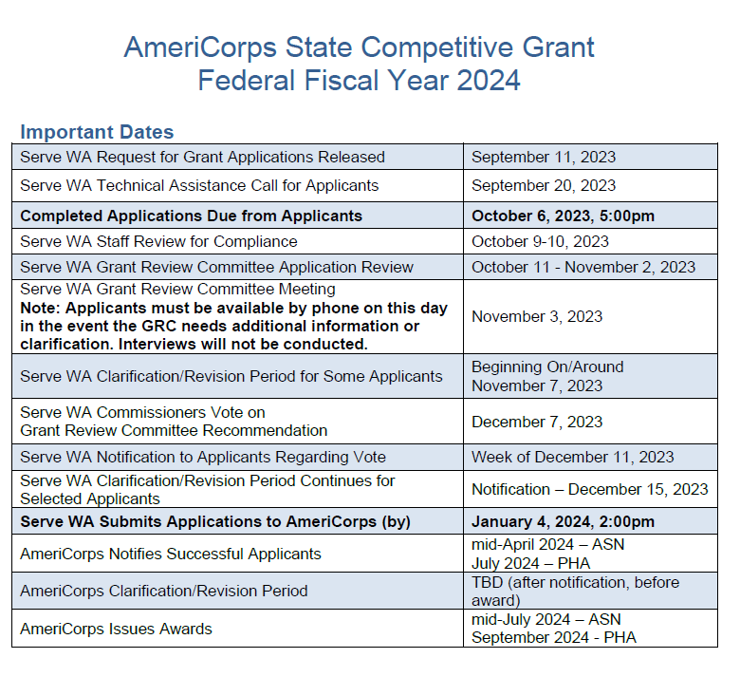
Serve WA RFGA

Slide 6
Serve WA RFGA
You submit grant in eGrants
Serve WA clarification if selected
Submitted to AmeriCorps
AmeriCorps
reviews
AmeriCorps clarification if selected
Awards made
You get a program and AmeriCorps members to help your organization and community!!!
(Operational Grant)
Serve WA & Grant Review Committee reviews and Serve WA Commission votes
Notes:
No matter when you apply…General flow of RFGA Process. Go over slide. Fall Competitive process 8-9 months; spring Formula process 4-5 months – both with periods of “wait time.”
However, before you can submit, there is a lot of work to do…

Slide 7
Serve WA RFGA
Request for Grant Application components:
Serve WA RFGA
basic overview, state requirements, WA priorities, important dates and timeline, application review process
AmeriCorps NOFO
federal priority areas, thresholds (such as cost per MSY and living allowances), application components and requirements (such as narratives, logic model, additional documents)
AmeriCorps Application Instructions
details on eGrants submission, budget instructions
AmeriCorps Supplemental Information
definitions of terms
AmeriCorps Performance Measurement Instructions
example measures, detailed instructions
Notes:
General overview of what to look for. Dive into narratives and budget today. Performance measures previous call. Go over slide.
Quite paperwork heavy; both a federal and state process. ☺

Slide 8
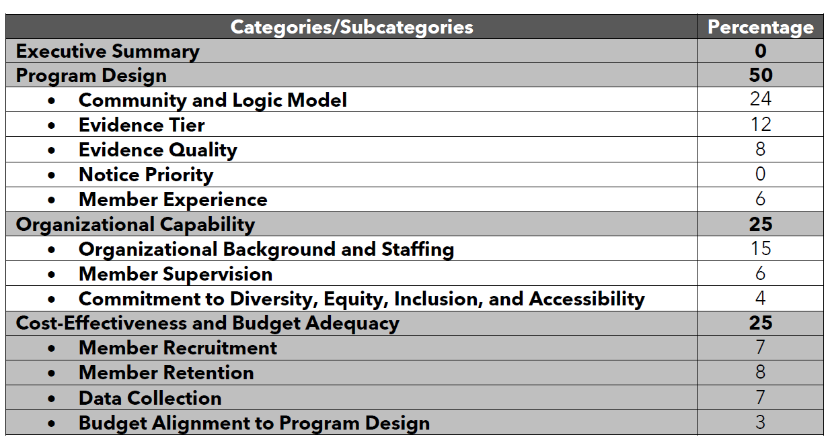
Application Narratives
Notes:
Go over slide.
For example…

Slide 9
“Homework”
Continue reviewing and reading AmeriCorps guidance documents.
Continue developing Theory of Change, Logic Model, Performance Measures, and Data Plan
Continue developing Policies & Procedures/Volunteer Plan.
Identify strategic partners if applicable.
Update budget framework.

Slide 10
Questions?
Notes:
You could guide them to the RFGA TTA recording if of value.

Slide 11
Resource(s)
Not sure about applying for an operational grant!?
Check out our Organizational Readiness page…
https://servewashington.wa.gov/funding-opportunities/eligibility-organizational-readiness
AmeriCorps Readiness Assessment
Navigating National Services Resource Flow Chart
Serve WA AmeriCorps Supplemental Information
Notes:
Most likely for you and your executive leadership as your organization continues on this journey…

Slide 12
Application Budget
Budget Instructions can be found in the AmeriCorps Application Instructions
Excel Budget Tool provided for work outside of eGrants
Two Budget Types (Financial Agreement)
Cost-Reimbursement
New applicants
Detailed, Line-Item budget
Reimbursement based on actual expenditures
Match required/reported
Fixed Amount
Long standing grantees OR those that can prove successful history for consideration
Budget based on cost per MSY
Reimbursement based on actual members enrolled
No match required/reported (though still necessary to operate)
Notes:
Go over slide.
Planning grants are all cost-reimbursable (current) so you know what that looks like. Most planning grants will be required to apply as cost-reimbursement under first operational grant unless already established as a fixed amount subgrantee (in another grant process such as state or national). Not going to talk much about fixed (its essentially straight forward in the application instructions and doesn’t apply to many planning grants or new grants). Also, fixed may look attractive but always two sides and most subgrantees “build up” to becoming fixed because of the associated autonomy, as well as requires high enrollment and retention to draw down funds.

Slide 13
Cost-Reimbursement Budget
Match Requirement
Cash or In-Kind
Minimum grantee share is 24% for the first 3 years. Overall grantee share increases gradually beginning in Year 4 to 26% and 50% by the 10th year of funding, if awarded.
Actual cash match needed may be higher; highly dependent on program design.
Public/Private partnership; grants are not intended to be solely funded by Federal Government.
Notes:
Go over slide. Planning grants are not part of the equation, only operational years

Slide 14
Cost-Reimbursement Budget
Federal Share
FY23 maximum Federal Share is $23,000 per MSY.
Remember, an MSY is equal to 1 FT AmeriCorps Member. (If using less than FT, pay attention to actual MSY.)
20 FT Members = 20 MSY = max $460,000
20 HT Members = 10 MSY = max $230,000
The federal share can be competitive, only ask for the maximum if necessary. That said, new programs are often funded at the maximum cost/msy.
Required Member Costs
FY23 living allowance for FT is $17,600-$35,200.
…plus benefits, healthcare, etc.
Notes:
Go over slide. Make a point to see that the federal share does not cover operating costs, may not even cover full member costs depending on program design.
Money should not drive program design; community need should drive whether member roles are FT or PT.
We hear from successful AC programs that per member (1 FT MSY) it is often $30-40,000 for total operating costs (cash!). Must have substantial cash match to run these programs. The federal share varies by grant opportunity.

Slide 15
Living Allowance
NOT a wage
Can base the living allowance on livable wage!
NOT paid hourly
Can base the living allowance on similar minimum hourly rates!
Pay continues uninterrupted while in-service, not tied to number of hours or leave time, programs can develop policies on pro-rated pay periods if service ends or begins in the middle of a pay period and zero-hour pay periods.
Intended to support individuals in meeting basic needs during service.
One example, you may want to consider the cost of living when determining the living allowance.
Notes:
[slide] verbally give example of 80% used in Handbook
RFGA will also tell you required minimum and maximums. Programs then make a determination within the range of the federal allowances.

Slide 16
Living Allowance
(PY21) Portfolio Snapshot for Full-Time
(PY20) Portfolio Snapshot for Full-Time
Range | $16,000-$30,200
Median | $19,374
Average | $20,680
Range | $14,279-$26,392
Median | $15,165
Average | $16,730
Notes:
Bit of a jump in recent years. Due to programs working on fund development to better support a more livable wage (though still very low in comparison to employment). Jenny, is the workbook far enough along to re-evaluate for PY22 example – when I looked it was definitely higher again this year and should be reflected here if possible?

Slide 17
Application Budget
As you prepare your budget:
Define amounts for particular use. (No miscellaneous or contingent amounts.)
Itemize each cost and present the basis for all calculations in the form of an equation. (Budget template will have space for “narrative” equations and final amount.)
$45,000 Program Director (90% of 50,000 salary)
$2,470 Annual Meeting (2 staff X $750 airfare + $50 ground transportation + (1 day) X $400 lodging + $35 per diem)
Do not include unallowable expenses. (Such as, “entertainment.”)
Necessary & Reasonable beyond just Allowable
Do not include fractional amounts (cents).
Budgets must comply with federal laws, regulations, and requirements of 2 CFR Part 200.
Notes:
Logistics for building the budget.
Go over slide.

Slide 18
Application Budget
Budget Worksheet
Section I – Program Costs
Personnel Expenses
Fringe Benefits
Travel – Staff and Members
Equipment
Supplies
Contract Services
Training – Staff and Members
Evaluation
Other Costs (you define)
Budget Checklist Available!
Section II – Member Costs
Living Allowance
FICA
Workers Comp
Health Care
Section III – Indirect
choose only one…
AmeriCorps Fixed Rate
Indirect Cost Rate
De Minimis Rate
Notes:
Should look familiar (same as planning grant), but with added sections to be used for operational grants, such as, member costs.
Go over each. Then address living allowance and health care. I’m never quite sure when to bring up the requirements for living allowance and health care. So I decided to throw it in with budget and will revisit with member benefits in the future. The law states you only have to provide a living allowance and health care for full-time members. However, we say that with caution. Is it more attractive financially to use a part-time model and not incur these costs, yes, but there are other things to consider, such as attracting people to serve, providing benefits consistently and fairly and that are ethical. Your program design should drive the model of full-time or part-time, not the budget, but if you land on part-time, you should consider what member benefits you will provide.
Template (including descriptions) to be sent, along with budget checklist.

Slide 19
Fund Development
Fund Development
Program Income - Cash
Organizational Match
Site Fee
Matching Federal/State/Local/Private Grants
Note: Matching Federal funds must be approved by the awarding Federal entity in writing (not AmeriCorps). See 2 CFR 200.306 (5)
Donors
Program Income – In-Kind
Site Supervision Time
Space
Gear/Tools/Supplies
Meeting Refreshments
Notes:
Go over slide.
2 CFR 200.306 (5) Are not paid by the Federal Government under another Federal award, except where the Federal statute authorizing a program specifically provides that Federal funds made available for such program can be applied to matching or cost sharing requirements of other Federal programs.
If you would like a standardized letter from Serve WA in support of fund development, please let me know.

Slide 20
Questions?

Slide 21
Closing

