Slide 1
Planning Grants – Grant Making & Budgeting
February 8, 2024
10am – 12pm
Please sign-in via the chat box:
Organization/Program
Name(s)
What travel destination is on your wish list?
Notes:
(Think through host/presenter/tech/chat/video off/mute on/recording/announce closed caption if available/music upon entry.)
Music https://www.youtube.com/watch?v=p2C3ckrBUyU
Read before recording, then record and post in chat…
The law requires consent prior to recording a person’s participation in an event. Please be advised that your image will be captured and recorded during the videoconference. Your participation in this videoconference equals consent to be recorded as required by law. We will be publishing this video on our website located at servewashington.wa.gov. If you do not consent to being recorded but choose to participate, please turn your camera off and use the chat feature to interact with the speakers. You may also disconnect now.

Slide 2
Announcements!
National Service Training Conference
Minneapolis, MN
Serve WA Subgrantee Gathering
(tentative)
Wednesday, April 24 at 10:00 am
Prior to Conference Kickoff
Notes:
The National Service Training Conference is in 2 months and I had a couple notes I wanted to make. Please make sure at least one person from your organization attends this. There is a virtual option in June that you can attend if timing or travel is a challenge, but the in-person will have more offerings and networking opportunities. Also, this is a great way to spend down your grants, especially since this whole cohort was late in getting their staff onboard. Also, they do always have a fiscal track so think about if there is someone in your fiscal office that will be involved with that side of the grant consider sending them. If you are exploring the website you will see that it says that that the kickoff is at noon on Tuesday, however we are planning to have a Serve WA subgrantee gathering Tuesday morning before the kickoff so keep that in mind as you make your travel arrangements. Be sure to use the discount code Program300

Slide 3
Learning To Date
Previous Content
AmeriCorps 101/Program & Fiscal Orientation
Locating/Reviewing/Reading AmeriCorps Guidance
Theory of Change/Evidence
Logic Models/Performance Measures/Data Collection
Policies/Procedures/Branding
Grant Making/Budgeting/Fund Development
Today’s Agenda
Recruitment
Enrollment
Next Up (March 14)
Member Benefits, Eligibility, and National Service Criminal History Checks
Notes:
[slide]
Next will be a discussion on member benefits, eligibility, and national service criminal history criminal history checks on Feb 8th

Slide 4
Questions to Consider
How many AmeriCorps members will be needed? Are the member activities allowable?
What are the characteristics and qualifications of desired AmeriCorps members?
How many staff members and what roles will be supporting the program and members?
How will the program ensure a diverse and inclusive AmeriCorps team?
How does this new knowledge change the budget/match in order to run a successful program?
Will you have host sites? What other partners are necessary to be successful?
How will you obtain the cash match necessary to operate the program?

Slide 5
Member Recruitment/Selection
A successful recruitment strategy is the foundation to a thriving AmeriCorps program and the initial step necessary for programs to reach their desired community impact goals
AmeriCorps members are the face of any program; selection and placement of members is crucial to the overall health of AmeriCorps at the national, state, and local level
Being up front about both the benefits and challenges can help place members who are more likely to complete their service term
Notes:
Our first topic for the day is member recruitment and selection. Unlike benefits and eligibility, this is really driven by program design – there are less “requirements” in this section. [slide]

Slide 6
Member Recruitment/Selection
AmeriCorps recruits for diversity
Programs must be accessible to all persons with or without reasonable accommodation
AmeriCorps embraces both a non-discrimination and non-harassment policy.
Program Handbook: Pages 24-25
Notes:
[slide]
This is I think one of those sections where it will be important to look in the Program Handbook for suggestive links and materials that I can’t fully cover today.

Slide 7
Reasonable Accommodation
Programs and activities must be accessible to persons with disabilities, and the subgrantee must provide reasonable accommodation to the known mental or physical disabilities of otherwise qualified members, service recipients, applicants, and staff. All selections and project assignments must be made without regard to the need to provide reasonable accommodation. As such, inquiries about the need for reasonable accommodation should take place after a member has been offered an AmeriCorps position.
The vast majority of accommodations are inexpensive. For those cases where reasonable accommodations are more costly, there is a limited amount of money available through AmeriCorps.
https://americorps.gov/about/agency-overview/disability-accessibility

Slide 8
Non-Discrimination
AmeriCorps is available to all, without regard to race, color, national origin, gender, age, religion, sexual orientation, disability, gender identity or expression, political affiliation, marital or parental status, genetic information and military service.
By legislation or design, some programs are tailored to particular age groups.
AmeriCorps has zero tolerance for the harassment of any individual or group of individuals for any reason.
https://www.americorps.gov/about/agency-overview/civil-rights
https://www.americorps.gov/members-volunteers/safety-security
Notes:
Expanded definition, more inclusive language…[slide]…and two important websites to visit.

Slide 9
Member Recruitment/Selection
https://www.youtube.com/watch?v=UEH3DHzV6vg&t=3s
Notes:
First want to show you a couple videos you may want to use…

Slide 10
Member Recruitment/Selection
https://www.youtube.com/watch?v=5eSSE9QJ4S8
Notes:
First want to show you a couple videos you may want to use…

Slide 11
Member Recruitment/Selection
How do I recruit nationally? Is this required?
Yes, AmeriCorps requires all programs to advertise recruitment in eGrants via the My AmeriCorps portal
Programs create “service opportunity” listings. This will connect the program to the national recruitment effort and will provide a one stop shop for programs to search for applicants (and applicants to find programs)
Notes:
…all with varying degrees of success; what’s your audience, what’s your strategy?

Slide 12
Member Recruitment/Selection
How do I recruit locally?
Most programs choose to also recruit locally outside the national system, and is encouraged as a holistic approach to recruitment and representation of community. Successful local recruitment may look different in each community.
Suggestions: Serve WA Platform – Service Year, Serve WA Marketing Starter Pack, AC Recruitment Hub Materials, Word of Mouth – Members and Alumni, Newspapers or Online Sources, Radio or Ads, Organization’s Website, High Schools/Colleges, Career/Volunteer Fairs
Notes:
…all with varying degrees of success; what’s your audience, what’s your strategy?

Slide 13
Member Recruitment/Selection
What else do I need to know?
Programs must develop their own selection process (screening, interviewing, etc.) and implement the process consistently
Document (at minimum) application or resume
Two references used to be best practice; however, we encourage programs to think through equity with all requested materials (might some materials, work/volunteer history, references discourage some people to apply or elevate some applicants unfairly)
Programs may not charge an application fee
AmeriCorps is not a J-O-B or W-O-R-K; remember to use terms such as serve, serving, performing service, national service position
Notes:
[slide]…I’m also going to post some flyers on your planning grant page, but definitely check out the handbook and some of our other resources. There are times when you may have to update the logo, we are working at this but in some cases programs are faster. You do have access to the WA AC logos, so use them!

Slide 14
Site Recruitment/Selection
Community Needs Assessment? RFP Process?
Natural Partnerships?
Within Grant Award Focus Areas
Overall Capacity
Knowledge of National Service
Dedication to Service Philosophy
Member Experience
Member Support/Supervision
Data Collection/Reporting
Financial Support (Match/Site Fee)
General Sustainability (3-yr Minimum)
Passing Through/Granting Dollars???
Additional Considerations, Discuss with Serve WA PO
Notes:
Don’t advise subgrants – increased compliance and fiscal monitoring required.

Slide 15
Enrollment/Exit
AmeriCorps requires programs to enroll and exit members electronically in eGrants/My AmeriCorps.
Pre-Enrollment…BEFORE member start date/hours.
Enrollment…within 8 CALENDAR DAYS of start date/hours.
Exit…within 30 CALENDAR DAYS of last day of service.
Notes:
Series of “in the weed” steps; it’s going to take the first few enrollments to fully understand and feel confident, and similar to NSCHC, doesn’t allow for human error without significant consequences to the program and member.

Slide 16
Enrollment
AmeriCorps requires programs to pre-enroll, and enroll members electronically in eGrants/My AmeriCorps.
Pre-Enrollment…BEFORE member start date/hours.
Enrollment…within 8 CALENDAR DAYS of start date/hours.
Well before this…programs should have completed “pre-work”…
Recruitment
Screening/Selection
Determined Eligibility
Completed and Adjudicated Criminal History Checks
Began Collection and Documentation of Member File
Notes:
…all this pre-work to ensure the individual is eligible and willing to be an AmeriCorps member, before you hit the eGrants system.

Slide 17
eGrants Pre-Enrollment
When program/member “pre-work” has been done, programs/members can begin electronic “pre-enrollment”…
BEFORE START OF SERVICE/HOURS
Program Invites/Selects Member in eGrants
Member Accepts and Fills Out Member Sections
Automatic/Manual Verification of Eligibility Occurs
Program Certifies Criminal History Check Verification
Program Completes Program Sections
…once these steps are completed, the “enrollment” button will be activated…
Notes:
Once you are convinced the individual is eligible and willing, you can start the electronic process of pre-enrollment. I compare all this pre-work and pre-enrollment to registering for college or applying for a job, etc., things we all do before we are accepted into anything…

Slide 18
eGrants Enrollment
When program/member “pre-enrollment” has been done, programs can finalize electronic “enrollment”…
Within 8 CALENDAR DAYS of START OF SERVICE/HOURS
Program clicks final enrollment button
the step of changing the status from pre-enrolled to enrolled cannot be completed until the first day of service and no later than 8 days after the first day of service
CAUTION! Disallowances (costs and/or member hours) may occur if programs are found to be non-compliant with enrollment.
Notes:
Cost disallowance…living allowances, member hours, domino effect on education award…

Slide 19
eGrants System of Record
AmeriCorps Terms and Conditions
Start Date in eGrants is Effective Date (system of record)
eGrants start date
MSA start date
Hours start date
MUST ALL MATCH
IF DATES DON’T MATCH
eGrants is the official date
Amend MSA to match eGrants
Disallow Hours prior to eGrants date
Notes:
Let’s look at it from another perspective…eGrants is the official system of record, but is comes later in the process, so it’s important that grant records all match…hopefully all goes well but let’s say the first day of orientation comes and then the second, and finally on the third day you find time to hit “enroll” – if there are any system hiccups and the start date is not what you projected it could impact the MSA and member hours to date.

Slide 20
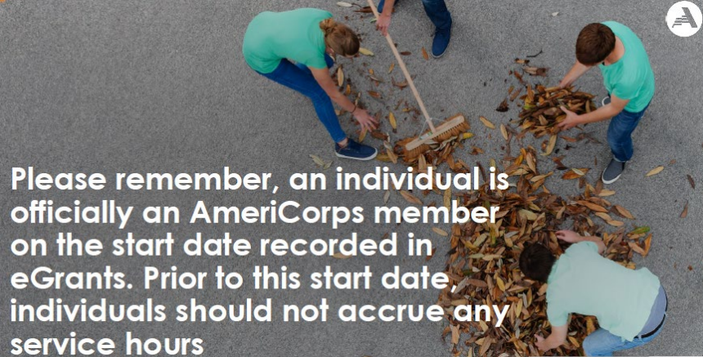
Notes:
You’ll see this floating around from the federal agency...

Slide 21
Pre-Enroll/Enroll Pitfalls
What are some common mistakes (human error)
with enrollment?
Poking applicants to complete their portion
Programs forgetting to enter NSCHC date box
Watching auto verification of eligibility (and submitting to AmeriCorps when returned for manual verification)
Allowing members to start/collect hours before pre-enrollment is complete (big NO)
Forgetting to complete final enrollment button once members start (will not back date more than 8 days)
Notes:
Now it’s not very fair for me to quiz you on a process you haven’t done, but what might you see as common human errors in this process and/or what jumps out for you as something to watch? Ask group to respond, then throw up list.

Slide 22
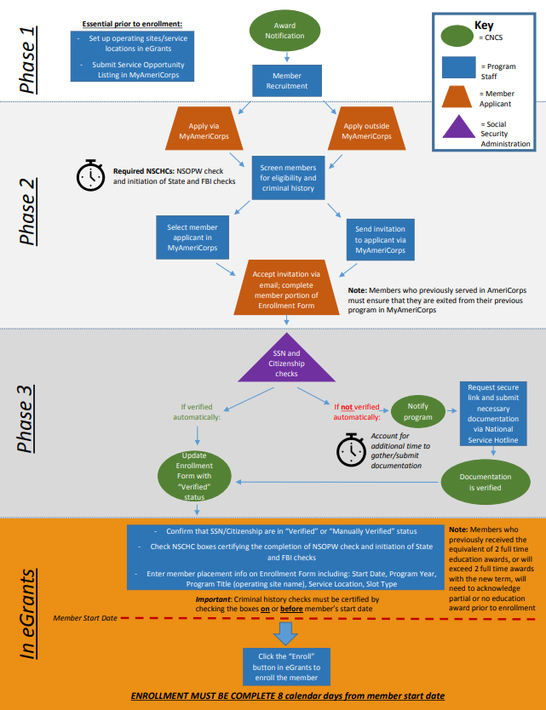
Enrollment Training Resources
Serve WA Pre-Enroll/Enrollment Checklist
Member Enrollment Flow Chart
Member Enrollment Presentation (PDF)
Member Enrollment Webinar (Recorded)
Notes:
Leave this here for folks to refer back to; I think the Serve WA checklist is the most up to date, the other resources are still helpful and they are constantly making tweaks to the process so here and there screens may look different (for example NSCHC used to be a checkbox, now you enter a date, etc.)…should be able to navigate or ask PO.

Slide 23
Exit
AmeriCorps requires programs to exit members electronically in eGrants/My AmeriCorps.
Exit…within 30 CALENDAR DAYS of last day of service.
Well before this…programs should have completed “pre-work”…
Documentation of Compelling Personal Circumstances (if applicable)
Corrective Action Paperwork (if applicable)
Performance Reviews
Final Timesheets
Program Exit Paperwork
Notes:
Just like enrollment…but much simpler…talk more about types of exits later…

Slide 24
eGrants Exit
When program/member “pre-work” has been done, programs can finalize electronic “exit”…
Within 30 CALENDAR DAYS before LAST DAY OF SERVICE
Program Unlocks Exit Form (if needed)
Member Fills Out Member Sections
Program Completes Program Sections
…the quicker a program exits a member, the quicker the member gets their education award (if earned)

Slide 25
Types of Early Exits
Only TWO types of early exits:
1) Release for Compelling Personal Circumstances
2) Release for Cause
“cause” isn’t always negative, it encompasses anything that doesn’t fall under compelling

Slide 26
Types of Early Exits
Release for Compelling Personal Circumstances
Performed satisfactorily
Completed at least 15% of term of service
Meets the criteria in 45 CFR 2522.230
Beyond participants' control
Disability or serious injury
Disability, serious injury, or death of family member
Natural disaster
Strike, site closure
Relocations of spouse/family
Military obligations

Slide 27
Types of Early Exits
Release for Compelling Personal Circumstances
Member receives pro-rated education award
Program receives positive retention rate for member position
Program may NOT refill positions exited with award
Program may NOT release for CPC for:
Employment
School
General Dissatisfaction
In rare cases, if the program design includes employment as the outcome, such as welfare to work, this may warrant CPC.

Slide 28
Types of Early Exits
Document Compelling Personal Circumstances
…the program must document the basis for any determination that compelling personal circumstances prevent a participant from completing a term of service…
At minimum:
Member request (email, letter, etc.)
Program support/corroborate (letter, note to file, etc.)
Source documents (such as medical, military obligation, etc.)
CAUTION! Protect/Secure any personal records.
Notes:
CFR tells programs to document…but not “how”…

Slide 29
Types of Early Exits
Release for Cause
Essentially any reason other than CPC
Members are not eligible for pro-rated education award
Member may still be given credit for satisfactory service (which allows the member to serve again)
Program retention declines
Program may refill member position in some cases

Slide 30
Types of Early Exits
In general when new to program management, it is best to contact your Serve WA Program Officer to discuss early exits.
AmeriCorps also outlines its policy on release in the AmeriCorps Terms and Conditions.

Slide 31
Slot Management
Slot Refills
Must fill unfilled eGrants slots first
Can only refill slots for members exited for cause
Members must have been released prior to completing 30%
Must have adequate time to complete (set new member up for success)
May not refill the same slot more than once
Notes:
…clarify 15% rule and 30% rule if asked

Slide 32
Slot Management
Slot Conversions
Unfilled and refill slots may be converted
Conversions must be “Trust neutral”
Conversions are not to be used in place of early exits
Notes:
…clarify 15% rule and 30% rule if asked

Slide 33
Slot Management
In general when new to program management, it is best to contact your Serve WA Program Officer to discuss slot refills and slot conversions.
AmeriCorps also outlines its policy on release in the AmeriCorps Terms and Conditions.
Notes:
Similar to Early Exits…

Slide 34
eGrants Tutorials
Learn all aspects of eGrants here:
https://servewashington.wa.gov/programs/americorps/subgrantee-resources/cncs-program-development-outlines
CAUTION!
Couple outdated components:
Hard copy enrollment/exit forms are no longer allowed. Everything must be done electronically.
Programs are no longer allowed to complete the member portions of enrollment/exit. Please be sure members are completing their own information.
Pre-Enrollment has a series of steps not covered in the tutorials.
Enrollment is required within 8 days, not 30 days.
Notes:
AmeriCorps (federal agency) is updating the eGrants tutorials, what we have is old PDFs of when the system first launched over a decade ago, still valuable – just pay attention when screens look different here and there, and ask for help. Cautions…couple things may not be as obvious…[slide]
When you come back to bookmark this, stick this cautionary piece close when reviewing the PDFs.

Slide 35
Member Performance Reviews
Full-Time Members
Mid-Term Review
End-of-Term Review
Part-Time Members
End-of-Term Review
Minimum Requirements For End-of-Term Review
Completed required number of hours?
Satisfactorily completed assignments?
Met program performance criteria?
Notes:
Program develop a tool that best suits their member development goals and program design goals. Include required questions on end-of-term review (or use Serve WA exit addendum template).

Slide 36
Deliverables
Member Recruitment Plan
Notes:
No templates

Slide 37
“Homework”
Continue reviewing and reading AmeriCorps guidance documents
Continue developing ToC, LM, PMs, Data Plan
Continue developing Host Sites and/or Strategic Partners as applicable
Develop systems for processing/documenting Eligibility
Develop draft Recruitment and Selection Plan
Update budget framework
Notes:
Suggestive

Slide 38
Questions?

Slide 39
Closing

