Slide 1
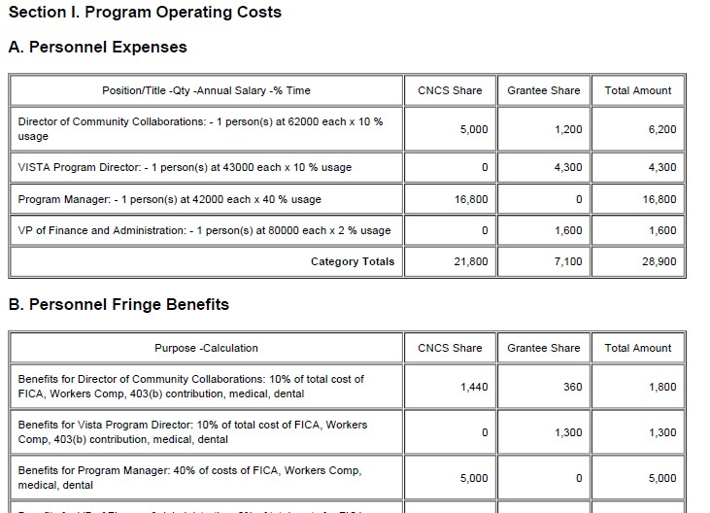
Budget & Budget Narrative eGrants
Federal share/grantee share
Line items (Category headings)
Budget Modifications and the 10% rule
Planning Grant Special Terms and Conditions IV

Slide 2
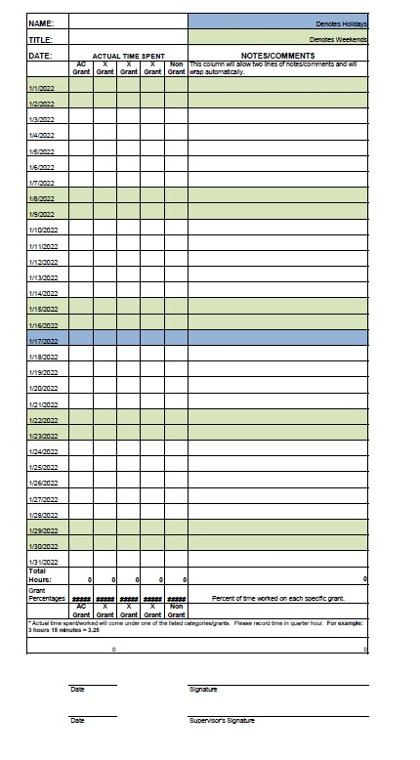
Timekeeping 2 CFR 200.430 Planning Grant ST&C II B
Staff timesheets should show ALL hours worked
Distinguish between grant and nongrant hours
Among grant hours, an allocation between grantee share and federal share that accords with PER should be recorded
Allocate based on ALL hours--30 hours is 75% of a 40 hour week, but 60% of a 50 hour week
Verified by employee and supervisor
Best practice is to invoice for reimbursement of payments PAID during reporting period

Slide 3
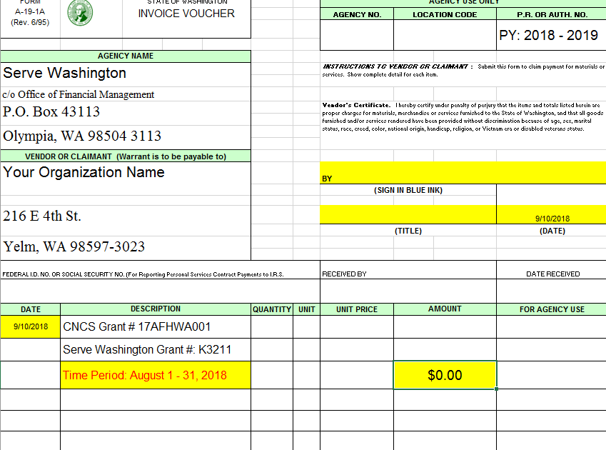
Invoicing/Drawing Funds Planning Grant Special Terms and Conditions II E1
Signed A19 invoice form in pdf format (template in workbook)
Excel workbook with PERs completed to date
Planning Grants provide an itemized GL and staff timesheets
Be sure to register as a state vendor

Slide 4
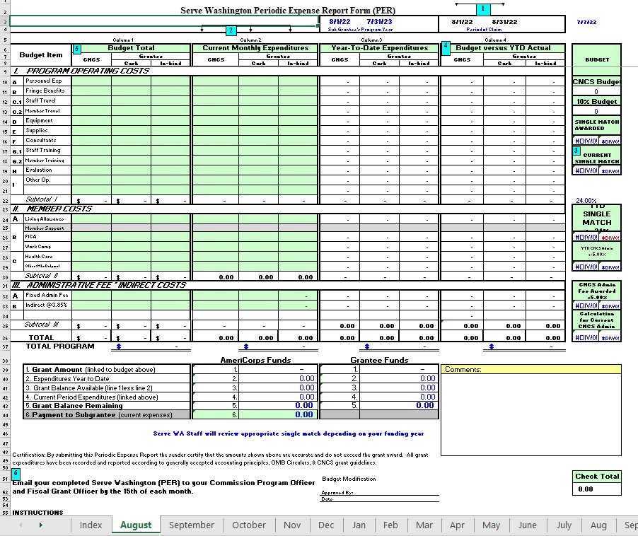

Slide 5
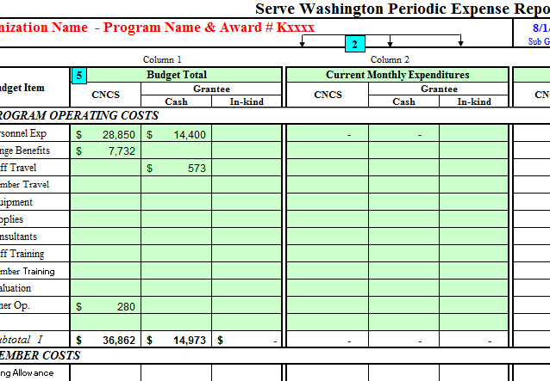
Invoice Package - PER
Periodic Expense Reports (PER) by Month in Fiscal Workbook
Fill out current monthly expenditures

Slide 6
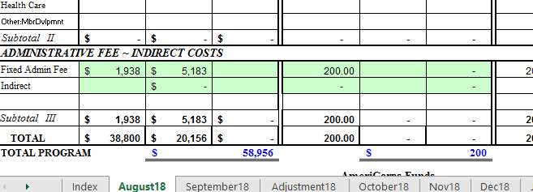
Invoice Package - PER
Periodic Expense Reports (PER) by Month in Fiscal Workbook
Fill out indirect costs

Slide 7
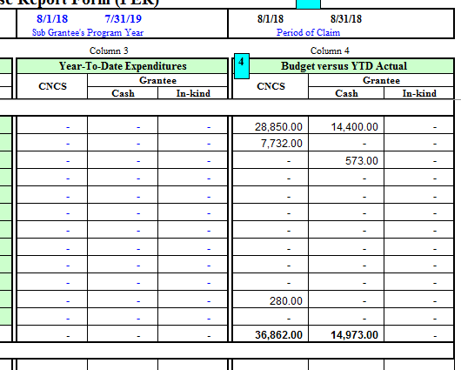
Invoice Package - PER
Periodic Expense Reports (PER) by Month in Fiscal Workbook
The form will track Year-To-Date and Budget vs YTD (auto calc)

Slide 8
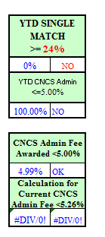
Invoice Package - PER
Periodic Expense Reports (PER) by Month in Fiscal Workbook
The form will also track if match percentage meets requirements

Slide 9
Invoice Package - PER
Periodic Expense Reports (PER) by Month in Fiscal Workbook
Total request for reimbursement located in bottom right

