Slide 1
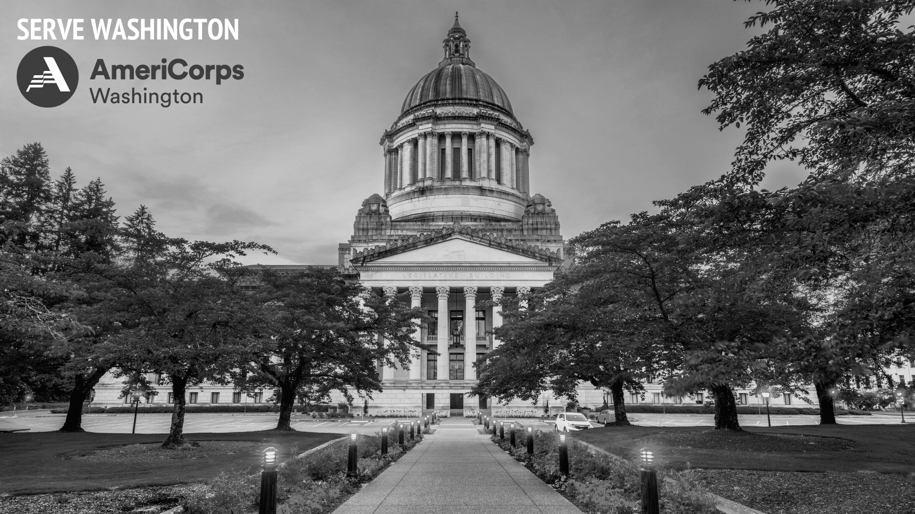
Planning Grant Orientation
August 24, 2023

Slide 2
WELCOME
In the chat box let us know:
Your Name
Your Organization
Are you an AmeriCorps Alum?

Slide 3
Objectives for Today
Introduction
What is AmeriCorps and Serve Washington
What will this year look like?
Overview of planning grant timeline and curriculum
Fiscal requirements
What do you need to know to manage federal funds compliantly
What AmeriCorps is NOT
Core rules, regulations, and statutes necessary for compliance
Key topics we will cover this year
Misperceptions about AmeriCorps and what members cannot do

Slide 4
Employment Security Department
Folk Education Association
The Moore Wright Group
Phoenix Conservancy
Your Money Matters

Slide 5
Serve Washington
Governor appointed state service commission
Support volunteerism and national service in WA
CERT, Volunteer Service Awards, Community Volunteerism, WA Climate Corps
AmeriCorps State programs

Slide 6
Key Serve Washington Staff
Amber Martin-Jahn
Executive Director
Strategic visioning
Lou Thompson
Management Analyst
Logic Models, Performance Measurement, Evaluation – data, data, data!
Mikia Guy
Director of Equity and Grants
Grantmaking
Jenny Benson (that’s me!)
Senior Program Officer
your primary point of contact
Thomas Darnell
Grants Officer
All things FISCAL

Slide 7
Serve Washington
Mission Statement
Serve Washington advances national service, volunteerism and civic engagement to improve lives; expands opportunity to meet the local critical needs of residents of Washington; and strengthens community capacity while creating healthy and resilient communities.
Vision Statement
National service, volunteerism, and civic engagement are the foundation for caring communities and a thriving Washington.
What brings you/your organization here today?
Notes:
[slide] As a kick-off exercise/icebreaker…That’s how we show up, what brings you and your organization here today (chat box or unmute/speak). While you are doing that, I would like to introduce our Executive Director, Amber Martin-Jahn…

Slide 8
AmeriCorps or CNCS?
AmeriCorps is the operating name for the Corporation for National and Community Service also known as CNCS. The dba AmeriCorps is frequently seen and referenced as the primary name for the federal agency; however, much of the statue and regulations still refer to the Corporation or CNCS. AmeriCorps, AmeriCorps the Federal Agency, the Corporation, and CNCS are all interchangeable. Serve WA materials lean towards the use of AmeriCorps or AmeriCorps the Federal Agency depending on context but leaves the Corporation and CNCS when directly quoting or citing a statue/regulation.
Notes:
A bit of a disclaimer as we get going this morning…during the first year of the pandemic (I think it was) the federal agency went through a massive brand change…

Slide 9
AmeriCorps Director Role
Are you the new “CEO” of your AmeriCorps program?
Executive Director
HR Manager
Case Manager
Accountant
Compliance Officer
Communications Specialist
Grants Manager
Social Worker
Supervisor
Contracts Specialist
Emergency Manager
Notes:
Today we are going to dig in briefly on what you can expect from the next year of planning…first…
YOU are the new CEO of your future AmeriCorps program…[slide]…what did I miss? (Media/Marketing, Fund Develop,…)

Slide 10
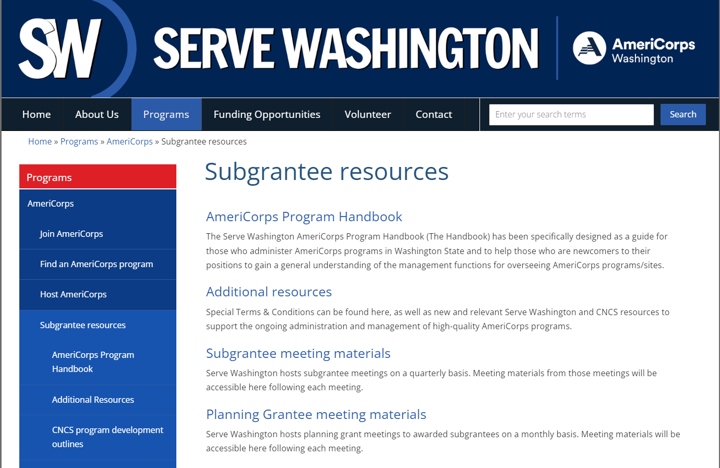
AmeriCorps Way of Life
Serve WA Online Subgrantee Resources:
Planning Grant Meeting Materials
Planning Grant Curriculum & Benchmarks
Recorded Webinars & Materials
Additional Resources
Serve WA Special Terms & Conditions (Planning Grant)
AmeriCorps Program Handbook
Guide for Operational Grants
Basis for our Planning Grant Period
Notes:
How will I learn all this stuff – “the AmeriCorps way of life”? That’s the beauty of a planning grant period.
Where can I access knowledge? [slide] – go to actual links and bring up materials
[show and walk-through curriculum doc]
[show preview of Handbook]

Slide 11
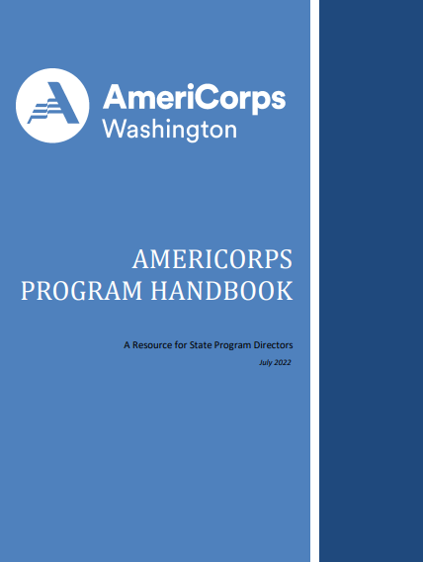
Program Handbook
Go to resource for any questions
Will cover everything over this next year
Bookmark this to refer to throughout this process

Slide 12
What Will We Do This Year?
Date | Topic | Location or Link
August 10 | Orientation | Zoom Webinar
September 14 | Program Design | Zoom Webinar
October 12 | Theory of Change and Evidence | Zoom Webinar
November 9 | Logic Models, Performance Measurement, and Data Collection | Zoom Webinar
December 14 | Policies, Procedures, and Branding | Zoom Webinar
January 11 | Grant Making, Budgeting, and Fund Development | Zoom Webinar
February 8 | Member Benefits, Eligibility, and National Service Criminal History Checks | Zoom Webinar
March 14 | Recruitment and Enrollment | Zoom Webinar
April 11 | Member Files and Required Documents | Zoom Webinar
April 24-25 | In-Person Regional Training Conference | Minneapolis, MN
May 9 | Designing your Calendars | Zoom Webinar
June 13 | Reporting, Record Retention, and Closeouts | Zoom Webinar
July 11 | Closeout and Final Thoughts | Zoom Webinar
July 17-18 | In-Person Subgrantee Meeting | Olympia, WA
10:00–12:00
Webinars every second Thursday of the month
Monthly 1:1 calls with Serve WA
Quarterly deliverables

Slide 13
Homework, Considerations, and Deliverables
Homework every month to work on to build the foundation of an AmeriCorps program
Questions to consider every quarter to help think through key elements
Deliverables every quarter required items for operational programs
Notes:
Flexible to meet each of you where you are at

Slide 14
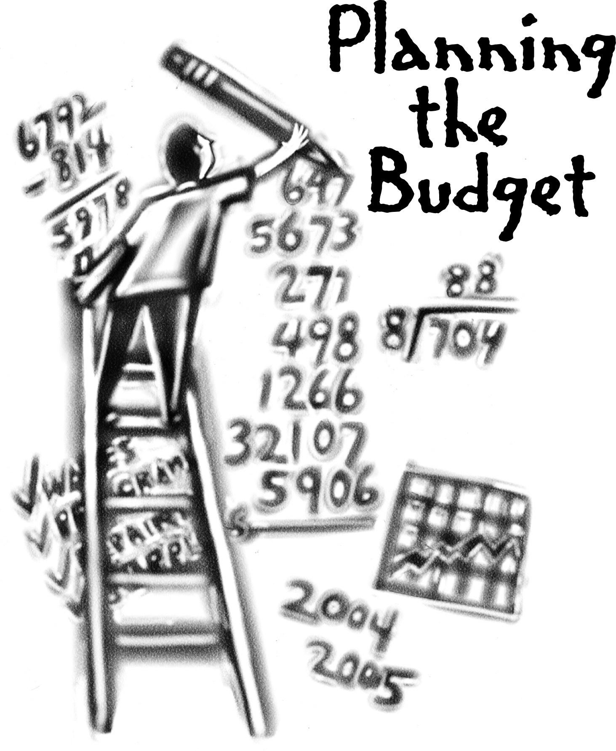
Let’s Talk FISCAL Grants Management
Notes:
More considerations than just the budget
Public private partnership – not fully funded by feds
Will talk fund development later

Slide 15
Resources
Serve WA Online Subgrantee Resources
Planning Grantees Meeting Materials
Additional Resources (PG Terms & Conditions)
AmeriCorps Program Handbook
eCFR :: 2 CFR Part 200 -- Uniform Administrative Requirements, Cost Principles, and Audit Requirements for Federal Awards
Fiscal Workbooks to be provided once contracts are complete

Slide 16
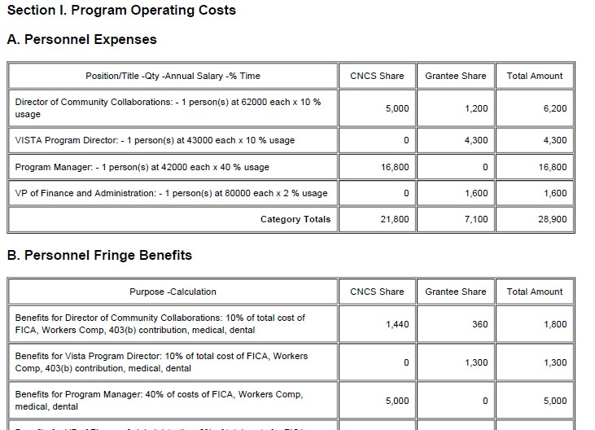
Budget & Budget Narrative eGrants
Federal share/grantee share
Line items (Category headings)
Budget Modifications and the 10% rule
Planning Grant Special Terms and Conditions IV

Slide 17
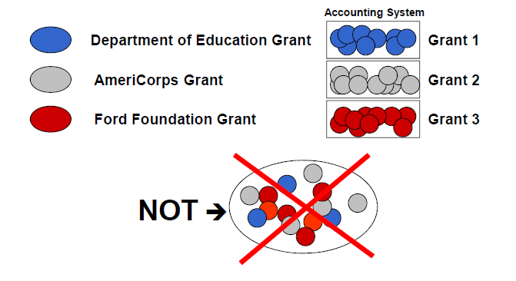
Financial Management 2 CFR 200.302
Everything reported in the PER should be verifiable with the General Ledger (GL) and documentation (receipts, etc)
We reimburse actual costs incurred, not speculative or estimated costs so that is what you should report to us
No AmeriCorps grant funds (including match) should appear as match on any other grant
All grant funds should be indexed and segregated clearly in itemized GL-no comingling

Slide 18
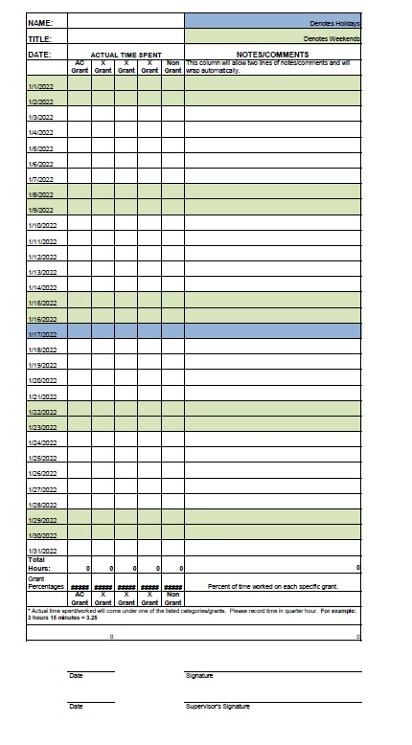
Timekeeping 2 CFR 200.430 Planning Grant ST&C II B
Staff timesheets should show ALL hours worked
Distinguish between grant and nongrant hours
Among grant hours, an allocation between grantee share and federal share that accords with PER should be recorded
Allocate based on ALL hours--30 hours is 75% of a 40 hour week, but 60% of a 50 hour week
Verified by employee and supervisor
Best practice is to invoice for reimbursement of payments PAID during reporting period

Slide 19
Acceptable Match 2 CFR 200.306
Cash & In-kind contributions are accepted as part of the grantee share/match when ALL the following are met:
Are verifiable from your organization’s records
Are not included as contributions for any other Federal award
Are necessary and reasonable for accomplishment of project or program objectives
Are allowable under Subpart E-Cost Principles
Are not paid by the Federal Government under another award, except where authorized
Are provided for in the approved budget
Conform to other provisions of the Omni Circular (Uniform Guidance)

Slide 20
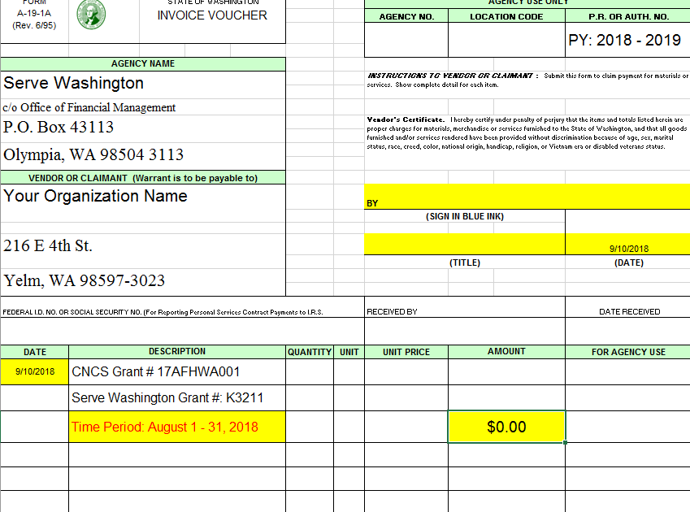
Invoicing/Drawing Funds Planning Grant Special Terms and Conditions II E1
Signed A19 invoice form in pdf format (template in workbook)
Excel workbook with PERs completed to date
Planning Grants provide an itemized GL and staff timesheets
Be sure to register as a state vendor

Slide 21
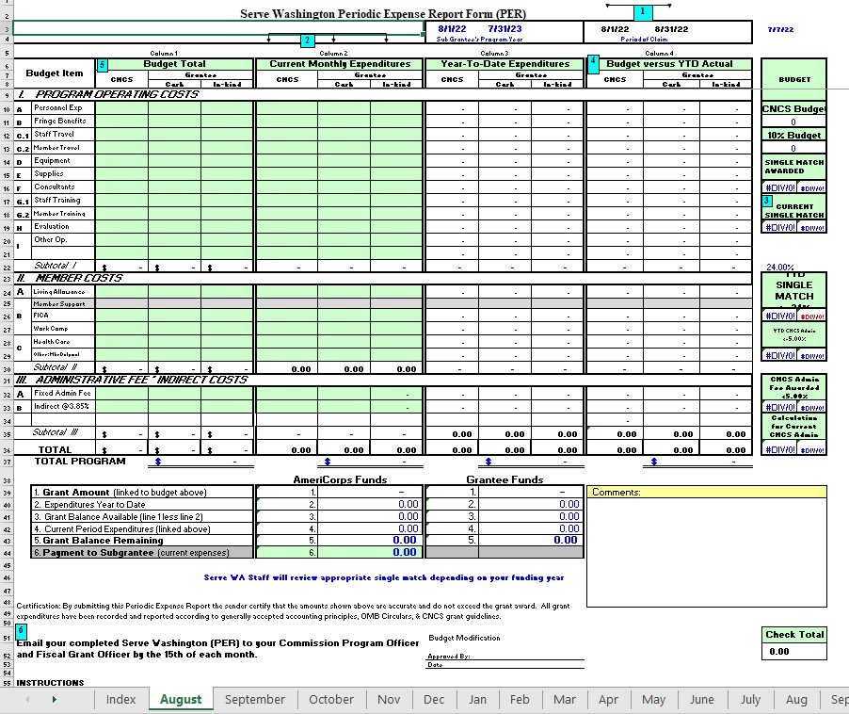

Slide 22
Other Fiscal Reporting
Midyear (April)
Planning Grant Special Terms and Conditions II E3, F
Program Income Report (restricted funding)
Other Federal Funds (used in match)
Unexpended (we may collect unexpended funds report)
Final (Grant Year End)
Closeout (we may collect closeout documents)

Slide 24
“The AmeriCorps Onion”
Nat’l & Community Svc. Act of 1990
Serve America Act
OMB 2 CFR § 200, CNCS 2 CFR § 2205,
CNCS 45 CFR § 2500
CNCS T&C for AmeriCorps State & Nat’l
CNCS General T&C
Serve Washington T&C
NOFO, RFGA, FAQs
Approved Application, Budget,
Pre-Award Negotiations, Assurances & Certifications
Notes:
As part of the governing principles, we like to think of things as peeling an onion…at the outer most ring…[slide]
Lots of governing documents; this is reflective of planning grant curriculum and benchmarks document, some of the initial homework to begin locating/reviewing.
Handbook will also point you to the exact governing document when applicable; we will be looking at very specific rules and regulations during our in-depth planning grant webinars. For example…eligibility…

Slide 25
National Service in WA
AmeriCorps
Washington, DC
AmeriCorps
Regional Office
Los Angeles, CA
AmeriCorps
VISTA
Statewide
AmeriCorps Seniors
Statewide
Serve Washington
Olympia, WA
AmeriCorps
State
Statewide
AmeriCorps National
Multi-State
Subgrantees
(You!)
Notes:
Let’s look at how all streams of service flow in our state and where YOU contribute to our national service footprint….[slide]

Slide 26
Lingo
Prime Grantee vs Subgrantee
Grant ID, Application ID, State Contract #
NOFO/A vs RFGA
Competitive vs Formula
Member Position, MSY, Slot Type
Cost-Reimbursement vs Fixed-Amount
Planning Grants:
Cost-Reimbursement Formula Subgrantee

Slide 27
AmeriCorps vs Employees
AmeriCorps members are NOT employees
By law, an AmeriCorps member is defined as a “participant” in an approved national service position. By rule, “a participant shall not be considered to be an employee of the organization receiving assistance under the national service laws through which the participant is engaging in service.” (42 USC 12511 30B) Furthermore, the US Department of Labor has clarified that an AmeriCorps participant is not an employee of the program for purposes of the Fair Labor Standards Act and is ineligible for unemployment insurance.
Notes:
Another important distinction [top slide] - ensure that we are avoiding terms like employee or job
[bottom slide] - meeting a new need, filling a gap, or building capacity
didn’t see any red flags in grant applications, but important to know before planning

Slide 28
Non-Duplication and Non-Displacement
AmeriCorps is not intended to duplicate activities already available in the locality of a program, may not supplant state or local funds, and may not displace an employee or volunteer position with an AmeriCorps member position.

Slide 29
Prohibited Activities
a. Attempting to influence legislation;
b. Organizing or engaging in protests, petitions, boycotts, or strikes;
c. Assisting, promoting, or deterring union organizing;
d. Impairing existing contracts for services or collective bargaining agreements;
e. Engaging in partisan political activities, or other activities designed to influence the outcome of an election to any public office;
f. Participating in, or endorsing, events or activities that are likely to include advocacy for or against political parties, political platforms, political candidates, proposed legislation, or elected officials;
g. Engaging in religious instruction, conducting worship services, providing instruction as part of a program that includes mandatory religious instruction or worship, constructing or operating facilities devoted to religious instruction or worship, maintaining facilities primarily or inherently devoted to religious instruction or worship, or engaging in any form of religious proselytization;
Notes:
Another important note before planning is to ensure that we aren’t planning for any prohibited activities…

Slide 30
Prohibited Activities
h. Providing a direct benefit to—
i. A business organized for profit;
ii. A labor union;
iii. A partisan political organization;
iv. A nonprofit organization that fails to comply with the restrictions contained in section 501(c)(3) of the Internal Revenue Code of 1986 related to engaging in political activities or substantial amount of lobbying except that nothing in these 9 provisions shall be construed to prevent participants from engaging in advocacy activities undertaken at their own initiative; and
v. An organization engaged in the religious activities described in paragraph (g.) above, unless CNCS assistance is not used to support those religious activities;
i. Conducting a voter registration drive or using CNCS funds to conduct a voter registration drive;
j. Providing abortion services or referrals for receipt of such services; and
k. Such other activities as CNCS may prohibit. (census, election, polling activities)
Notes:
Another important note before planning is to ensure that we aren’t planning for any prohibited activities…

Slide 31
Non-Discrimination
AmeriCorps is available to all, without regard to race, color, national origin, gender, age, religion, sexual orientation, disability, gender identity or expression, political affiliation, marital or parental status, genetic information and military service.
By legislation or design, some programs are tailored to particular age groups.
AmeriCorps has zero tolerance for the harassment of any individual or group of individuals for any reason.
Notes:
[slide] …I’m talking a lot, this is not the most interactive presentation, so let’s take a break…

Slide 32
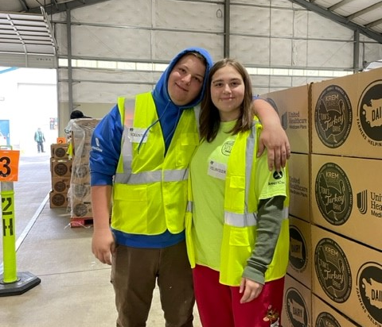
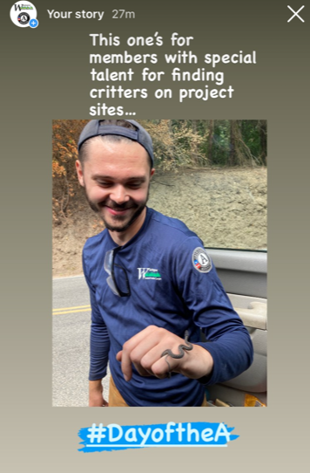
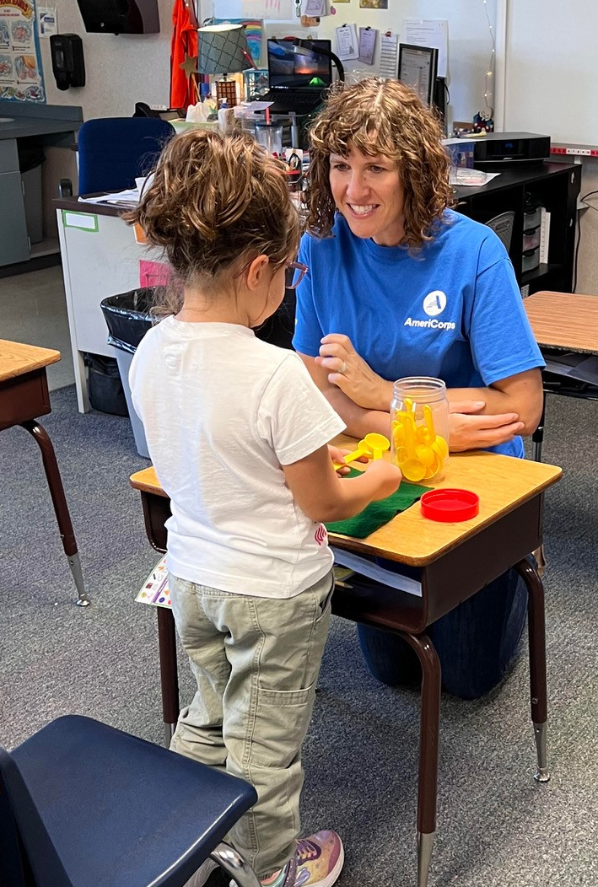
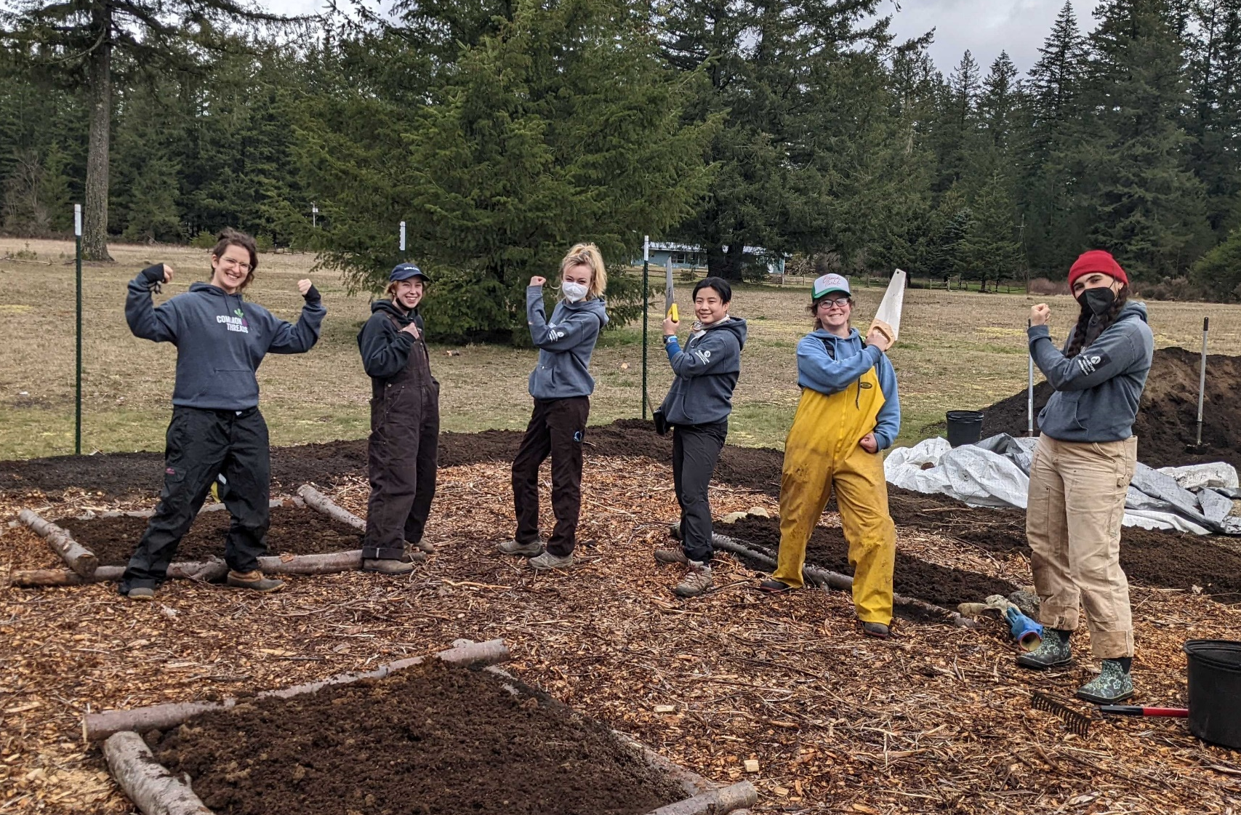
So, What CAN AmeriCorps Members Do???
50,570
Volunteers Recruited and Managed
3,200,424
Volunteer Hours
38,635
Children and Youth Served
7,565
Acres of Public Land Supported

Slide 33
AmeriCorps Alum Lylianna Allala
Notes:
Pause for a moment, and give you a little inspiration/insight into the AmeriCorps member experience…[slide]…we have a handful of videos on our Serve Washington You Tube channel.

Slide 34
National Service Criminal History Checks
AmeriCorps: NSCHC Website
Program Handbook: Pages 26-29
NSCHC E-Course: AmeriCorps Learning Management System (Litmos)
Staff identified as having a role or responsibility in conducting and documenting NSCHCs must complete this training annually.
Notes:
Key Concepts that we will cover but want to make sure you hear!
NSCHC (National Service Criminal History Check) is one of the most important “compliance” aspects of AmeriCorps programming, AND more importantly is written into statute for the safety of members and service recipients. Going to learn and test this in-depth during the planning grant year, but important to mention now because organizations often assume their own standard HR practices would cover this requirements; however, AmeriCorps legislation actually outlines in law a very specific process for NSCHCs and most likely differs from your HR policies and procedures. In which case, sometimes both have to occur for staff working on an AmeriCorps grant and AmeriCorps members at their sites.
[slide]
Let’s briefly talk about the rules just to plant the seed…

Slide 35
National Service Criminal History Checks
All AmeriCorps members and staff in positions in which they will receive a salary, directly or reflected as match, under a cost reimbursement grant
refers to operational grants, planning grants will run staff to learn the process in order to be compliant and timely for an operational grant
Four-part check REQUIRED
Must be adjudicated BEFORE serving or working
Serve Washington requires programs to use approved vendors
Notes:
Individuals who:
Refuse to consent to NSCHC
Make a false statement in connection with NSCHC
Are registered, or required to be registered, on a state sex offender registry or the National Sex Offender Registry
Have been convicted of murder

Slide 36
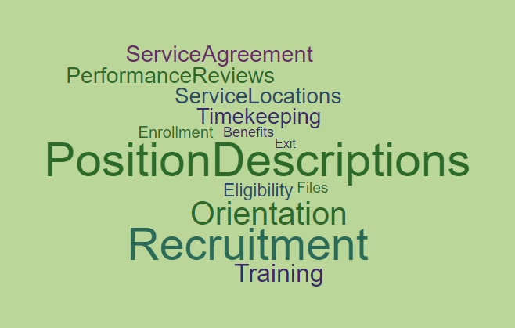
Member “Stuff”
Notes:
Why aren’t we talking about members? That’s what I’m here for! Covered in chapters 3 & 4, and what the curriculum will cover in-depth.

Slide 37
Records Retention
Specific to Planning Grants:
Fully executed contract/grant
Fiscal records
Fiscal support documentation
Program planning materials
NSCHC training certificate
Keep Until Notified by Serve Washington
(See Planning Grant Special Terms and Conditions)
Notes:
It’s important to keep an auditable history by grant year. [slide] Starting now, you are working on an auditable grant.
Feds 3 years; WA State higher req 6 years; based on prime – we tell you! Refer to PG ST&C.

Slide 38
Operational Grant Opportunities
Roll from planning grant directly into operational grant Program Year 24-25
Fall 2023
Competitive Competition
Fall 2024
Gap year between planning grant and operational grant Program Year 25-26
Spring 2024
Formula Competition
Competitive Competition
Spring 2025
Formula Competition

Slide 39
Questions???

Slide 40
Next Steps
September 14 at 10:00 – Program Design
What does a term of service look like? – slot types and term length
What can AmeriCorps members do? – Prohibited and allowable activities
Where will AmeriCorps members serve? – Site selection and oversight
1:1 support calls
Connect with us!

