Slide 1

Planning Grants –
Theory of Change + Evidence
October 12 – 10am
Please sign-in via the chat box:
Organization/Program
Name(s)
What is your favorite movie of all time?
Notes:
Jenny: Host (tech/chat/video off/mute on/recording/announce closed caption/music upon entry) https://www.youtube.com/watch?v=dI3toQVr9e8
Lou Presenter
(Jenny) Read before recording, then record and post in chat…
The law requires consent prior to recording a person’s participation in an event. Please be advised that your image will be captured and recorded during the videoconference. Your participation in this videoconference equals consent to be recorded as required by law. We will be publishing this video on our website located at servewashington.wa.gov. If you do not consent to being recorded but choose to participate, please turn your camera off and use the chat feature to interact with the speakers. You may also disconnect now.

Slide 2

Resources…reminder…
Serve WA Online Subgrantee Resources:
Planning Grant Meeting Materials
  Planning Grant Curriculum & Benchmarks
  Recorded Webinars & Materials
Additional Resources
  Serve WA Special Terms & Conditions (Planning Grant)
AmeriCorps Program Handbook
  Guide for Operational Grants
  Basis for our Planning Grant Year
Notes:
(last time I’ll show this)

Slide 3
Objectives for Today
Theory of Change
Building Evidence
Community need
Intervention
Outcomes
Program Effectiveness
Evidence Continuum
Reminder:
Fiscal Invoices Due on Sunday

Slide 4
2 Part Webinar
Theory Of Change (TOC): Designing Effective Action for Change
https://americorps.gov/sites/default/files/modules/module-2-designing-effective-action-for-change/story.html
Building Evidence of Effectiveness
https://americorps.gov/sites/default/files/modules/module-3-building-evidence-of-effectiveness/story.html
Notes:
Lou – introduce self.
Welcome to the 2 in 1 webinar
Each of these webinars are available in full at the links on the screen – for today, a few slides have been removed in the interest of time and a few have been added to increase audience participation.

Slide 5

Designing Effective Action for Change
How a Theory of Change helps you clarify the cause-and-effect relationship at the heart of your program
Copyright © 2012 by JBS International, Inc.
Developed by JBS International for the Corporation for National & Community Service
Notes:
https://americorps.gov/sites/default/files/modules/module-2-designing-effective-action-for-change/story.html
begin with the Theory of Change Module: “Designing Effective Action for Change.” This first module will describe how a Theory of Change helps you clarify the cause-and-effect relationship at the heart of your program.
POLL: On a scale of 1-10, with 1 being not at all familiar and 10 being completely familiar – where do you fall?

Slide 6
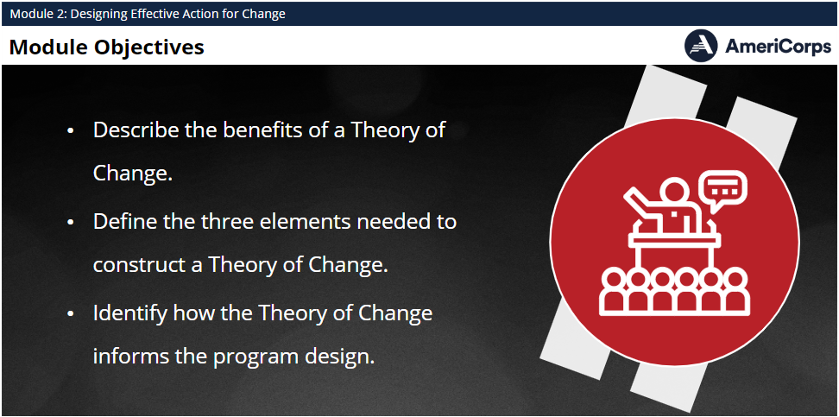
Learning Objectives
By the end of the module, you will be able to:
Describe the benefits of a Theory of Change
Define the three elements needed to construct
Notes:
This module is designed to give you an overview of Theory of Change.
By the end of the module, you will be able to:
Describe the benefits of a Theory of Change
Define the three elements needed to construct a Theory of Change
Identify how the Theory of Change informs the program design

Slide 7
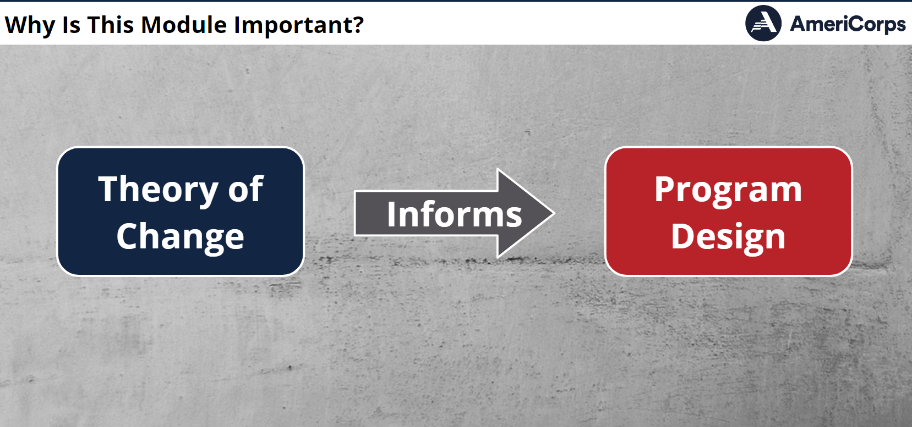
Theory of Change Perspective
Notes:
For program design to work as intended, there needs to be logical connection between the need, the intervention, and the expected outcome. The Theory of Change is the essential “backbone” of a program that enables all the pieces to fit together.

Slide 8
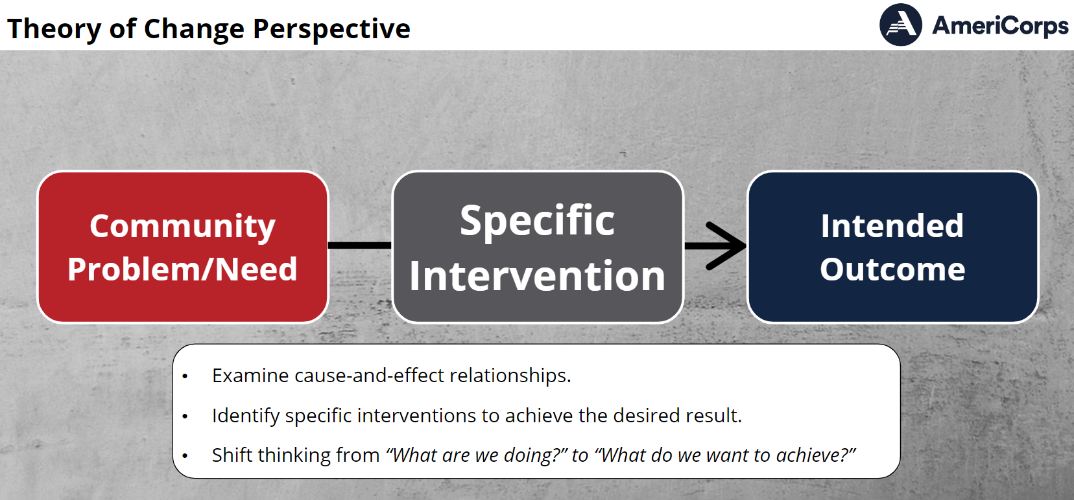
Theory of Change Elements
Notes:
A theory of change has three main elements:
There is the community problem or need to be addressed.
There is a specific intervention, a set of activities that you have chosen to address the need based on evidence that a similar approach has worked in the past.
There is the intended outcome – if you deliver the intervention according to plan, it will bring about a measurable positive change in the community in relation to your targeted need.
As you develop a theory of change for an issue that your program will address, you identify where you are now, as well as the change for which you are programming. You will choose certain activities based on their link to your desired outcomes.

Slide 9
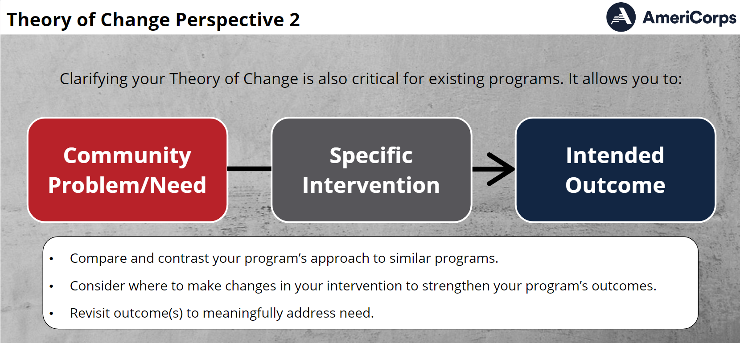
Theory of Change Perspective
Notes:
Developing a theory of change requires you to articulate assumptions underlying your choice of activities by documenting why you think the activities will lead to the intended change.

Slide 10
Theory of Change Perspective
the most effective
set of activities
for volunteers
and participants
Community Problem/Need
Specific Intervention
Intended
Outcome
Shifts thinking from “what we are doing” to focus on “what we want to achieve”
  Adapted from www.theoryofchange.org/about/
Notes:
Clarifying your theory of change is also critical for existing programs as it offers you an opportunity to compare and contrast your program’s approaches and context to similar programs and allows you to consider where to make changes to strengthen your program’s outcomes. Constructing a theory of change also offers you the opportunity to revisit your choice of outcome(s) to insure there is a logical and practical relationship between the service you provide (your intervention) and the change you intend to make.

Slide 11
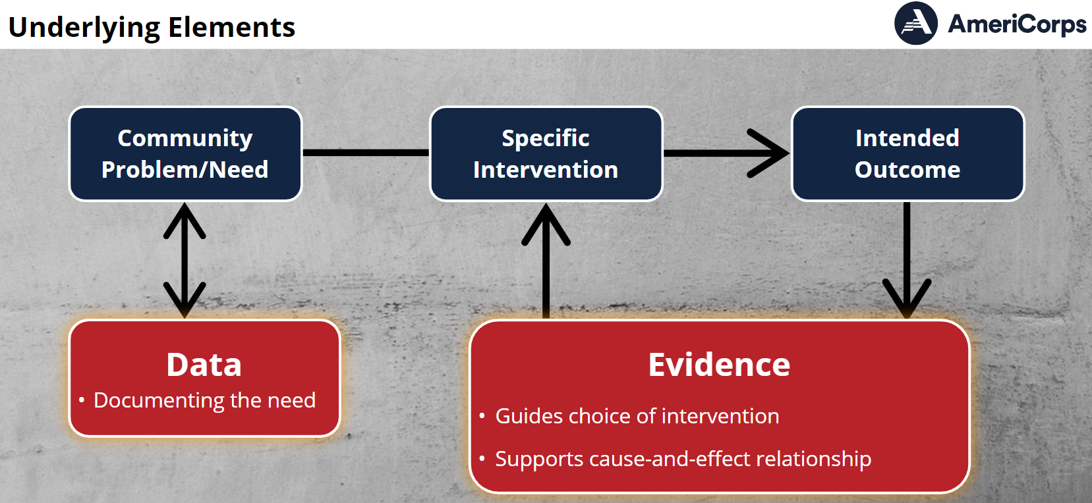
Theory of Change Elements
Notes:
Underlying elements to main elements are:
Data that documents the extent and severity of the community problem/need you will address; and
Evidence that informs your understanding of why a particular intervention will result in the change identified in the outcome. [Note: Evidence will be covered in more depth in the third module.]

Slide 12
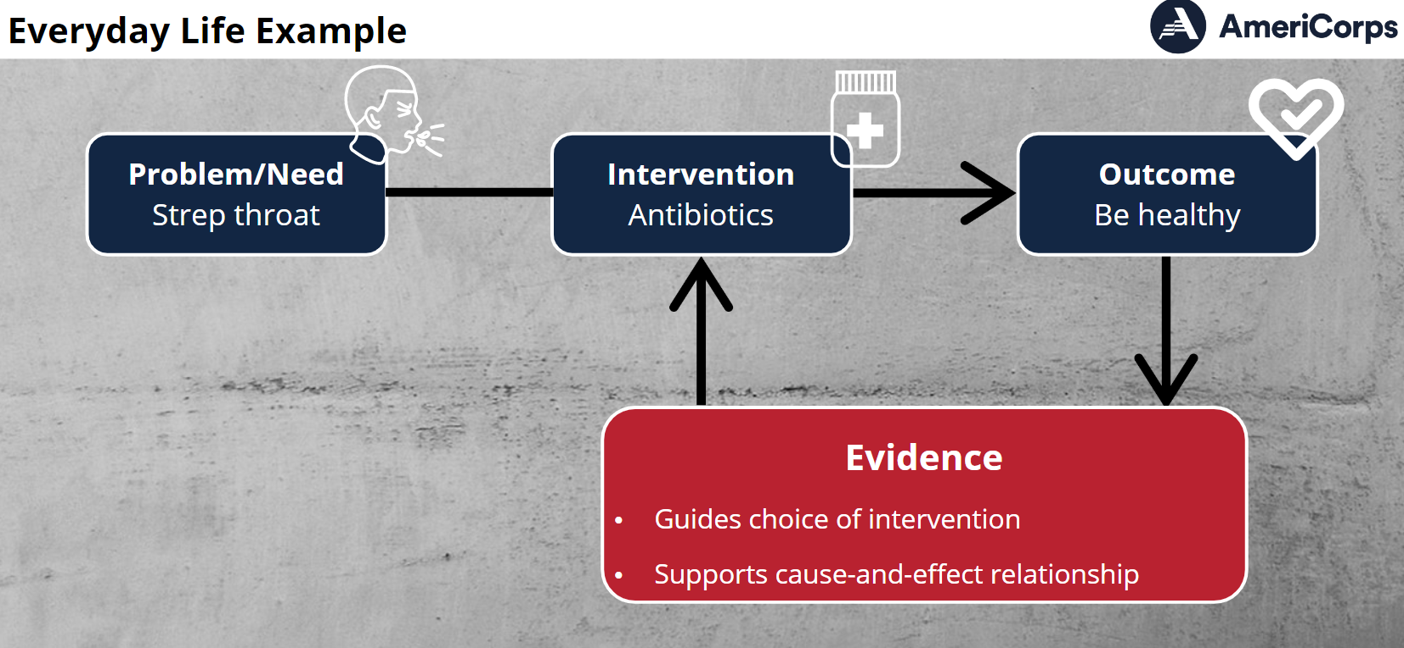

Everyday Life Example
I have strep throat (problem)
I will take antibiotics (intervention)
I will get better (outcome)
Notes:
Let’s walk through an example of what a theory of change looks in everyday life. Medicine provides us with some of the most familiar examples of how theories of change show us a pathway from problem to solution.
If you have strep throat, then the intended outcome is wellness. Taking antibiotics is on proven way to get there.

Slide 13
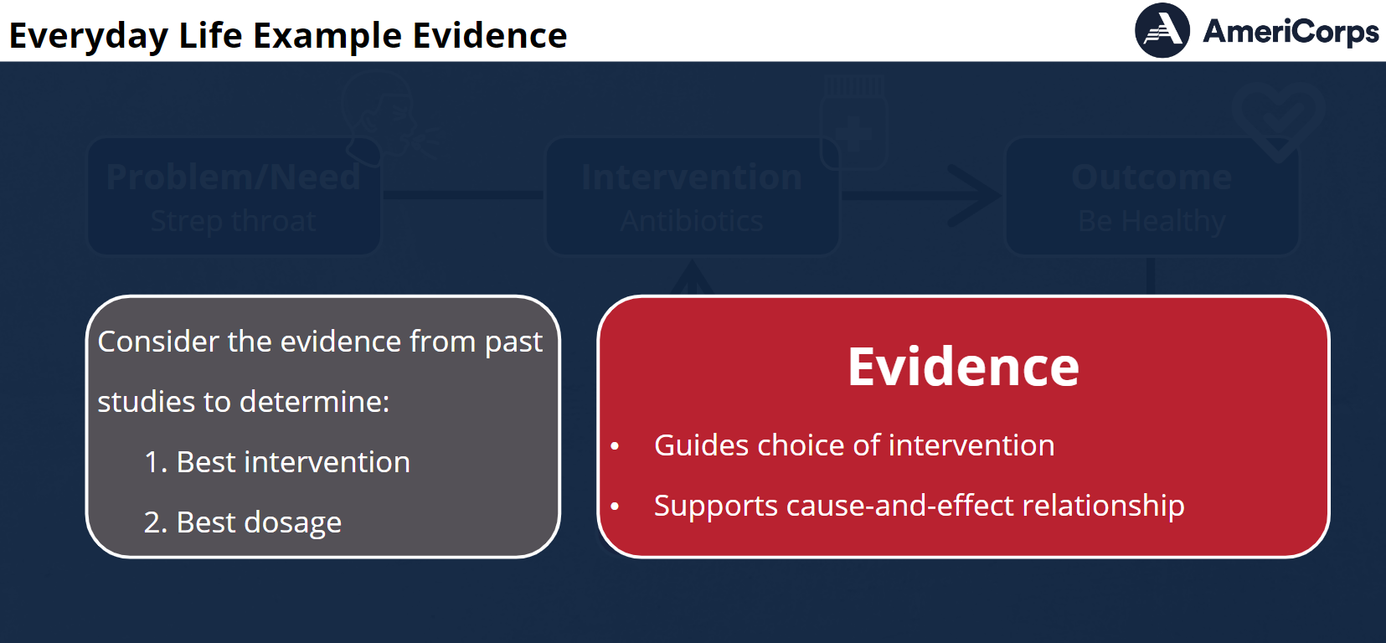
Everyday Life Example
Evidence:
 Guides choice of intervention
 Supports cause-effect relationship
Notes:
But every antibiotic is not equally effective with strep, so you need to consider the evidence from past studies to determine the best possible intervention or which antibiotics are best to fight strep.
Penicillin has been proven very effective in fighting strep when taken a certain number of times a day for a period of time – making it a good choice.
Tetracycline is also a powerful antibiotic – but it isn’t effective for strep throat.
You take 500 mg of penicillin twice a day for 10 days – and you get well.

Slide 14
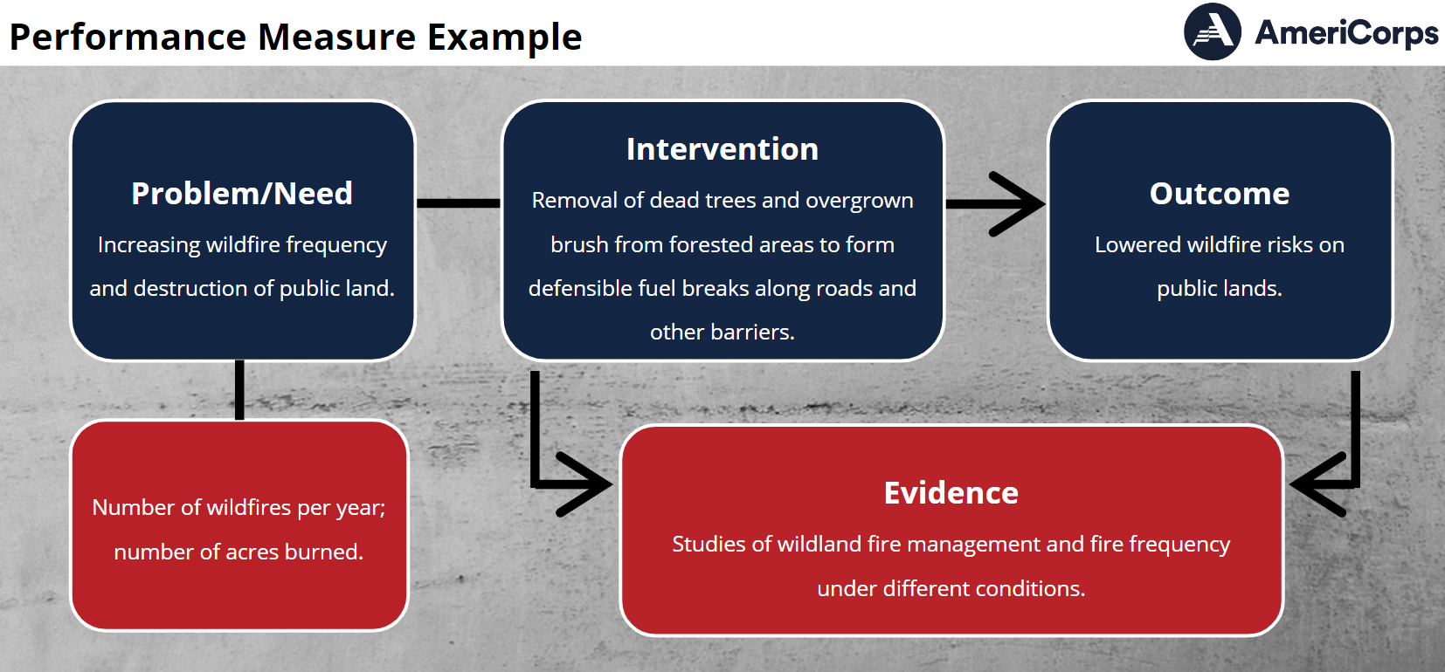
Example:
Riverton Literacy Corps
Community Problem/need
Children reading below grade level in 3rd grade
Notes:
Now let’s look at an example for a national service environmental program.
The community problem is that ...
This is supported by data documenting the …

Slide 15
Example:
Riverton Literacy Corps
Community Problem/need
Intended
Outcome
Children reading below grade level in 3rd grade
Students are able to read at 3rd grade level (as measured by 3rd grade reading exam)
Statistics on the number of students at below grade level in program’s service area; Research on why reading proficiency by 3rd grade is important.
Notes:
The intended outcome sought by the program is for students to be able to read at third grade level as demonstrated by passing the state reading exam.

Slide 16
Example:
Riverton Literacy Corps
Community Problem/need
Specific Intervention
Intended
Outcome
Children reading below grade level in 3rd grade
Individualized tutoring 3 times/week for 20 min on five “building block” literacy skills through reading, writing and verbal communication activities
Students are able to read at 3rd grade level (as measured by 3rd grade reading exam)
Statistics on the number of students at below grade level in program’s service area; Research on why reading proficiency by 3rd grade is important.
Evidence: Research on building block skills leading to reading proficiency. Research on design, frequency, duration of tutoring sessions.
Notes:
The intervention will provide individualized tutoring to students identified as not meeting reading benchmarks. This tutoring will focus on five “building block” literacy skills through integrated reading, writing and verbal communication activities. Research has shown this curriculum model to be linked to demonstrable improvement in reading skills. The research outlines the specifics of the intervention that yielded the intended outcome.

Slide 17
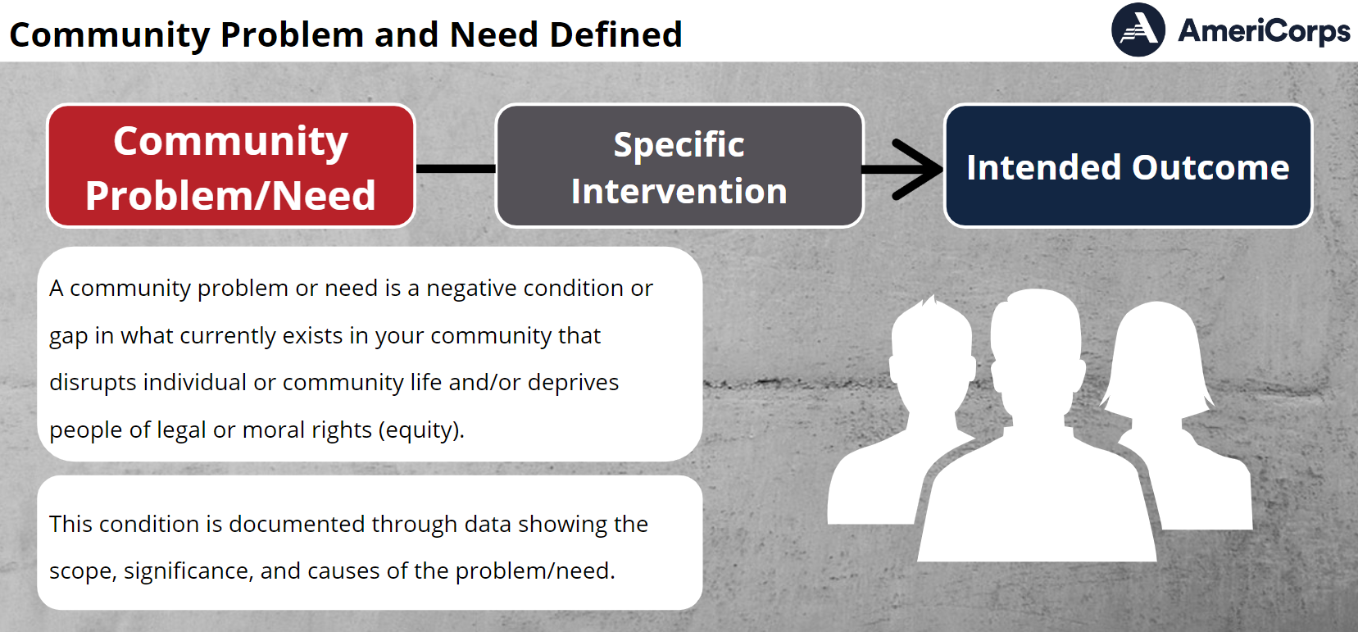
Theory of Change Elements
Community Problem/Need is the specific issue your project, with its specific intervention (service activity), is designed to address. What is the extent and severity of this need in the community?
Notes:
In your planning grant application, you were asked to describe the community need(s) your organization is hoping to address. You were to provide information about the scope/significance/cause of the problem in the community(ies) where your organization will focus its efforts, using reputable/current/local data.
Let’s go over this in more detail now. The community problem is the negative condition that exists; the community need describes the extent/severity of the problem in your community.
For example, if a community has a number of teens overdosing on opioids, you would ask questions such as what is the problem; i.e. what does the research say about the risks and impacts of this? How extensive is the problem in the community; i.e. 2%, 5%, of the teens? And what does this mean to our community?
The description of the problem as well as the specific community need should be supported by statistics, facts and figures from current and reputable sources.
As you read about and study the problem, you gain an understanding of it which will help lead to your chosen intervention.; i.e., do health classes cover the topic? Does the community offer programs in which teens could become involved? How is the problem described and analyzed in the literature and in conversations? What has been tried, whether or not it has worked? It is useful to know what doesn’t work as well as what does.

Slide 18
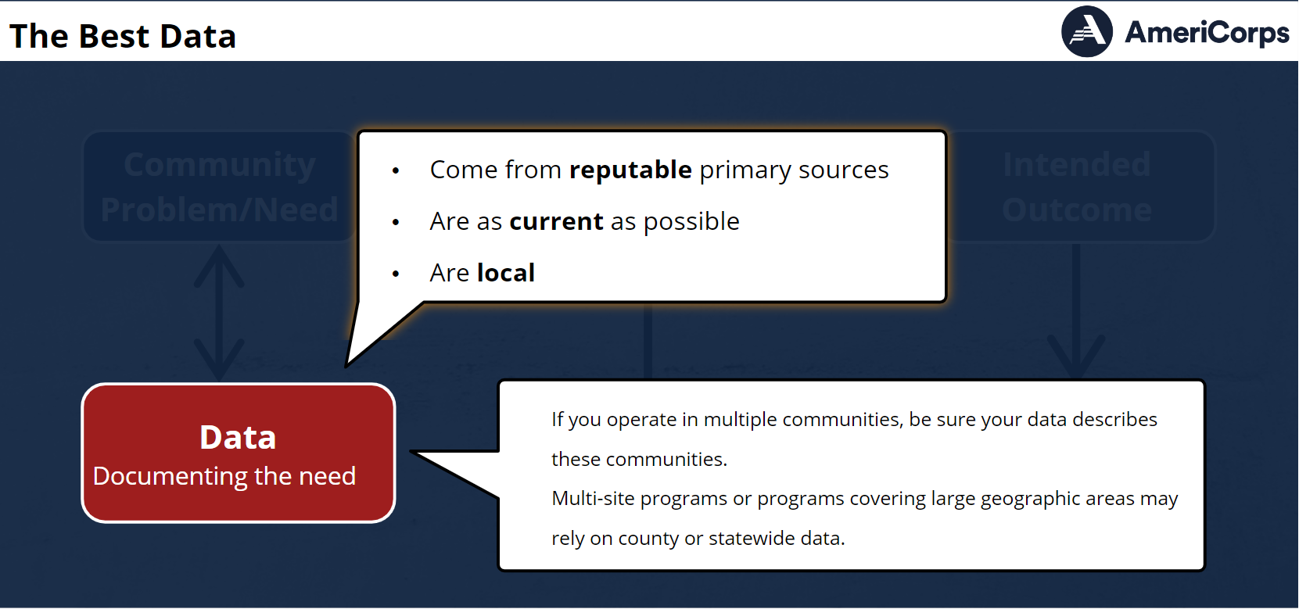

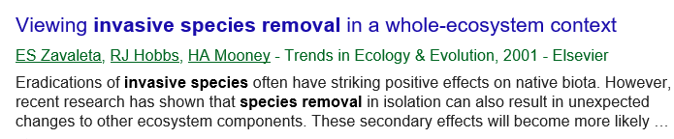
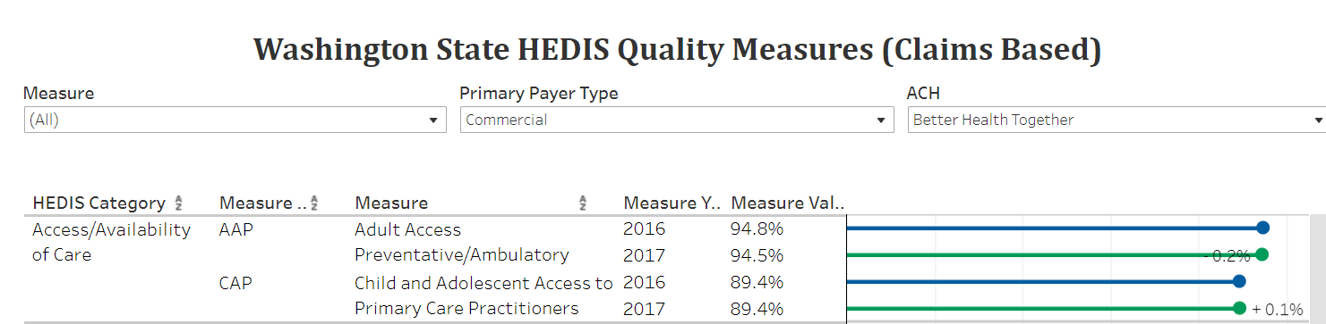
Theory of Change Elements
Statistics
documenting the problem/need
Notes:
The best data:
Come from reputable primary sources, such as government agencies, institutes, foundations, and universities that have conducted their own research. News reports are NOT primary sources. Data from multiple (reputable) sources increases reliability.
Up to Date - no hard and fast rule. AmeriCorps has used within the last 6 years for research.
Locally relevant – are you serving 1 county? A specific school district? A particular bioregion? national-level and state-level statistics don’t tell us about the problem as it affects the community where your intervention will be implemented. If you operate in multiple communities, be sure your data describe these communities. Multi-site programs or programs covering large geographic areas, may rely on county or statewide data. It needs to be clear why you selected particular communities for your intervention. The goal here is to find and use data as close to the source as possible.

Slide 19
Searching for Statistics
The best data come from reputable primary sources, (such as government agencies, institutes, foundations, and universities that have conducted their own research), are as current (up to date) as possible, and are as locally relevant, as possible.
Notes:
As we are answering all of those questions, we are looking for data that meets these criteria. By reputable, we mean: Source with no stake in outcome. For research, it should be published in a peer reviewed journal or by credible organization.
Up to date – no hard and fast rule. CNCS has used within the last 6 years for research.
Locally relevant – are you serving 1 county? A specific school district? A certain bioregion?
Examples on next slide

Slide 20
Searching for Statistics
Examples
Census data
County Health Rankings
Office of Superintendent of Public Instruction
Environmental Protection Agency
CDC’s Social Vulnerability Index
Department of Natural Resources
Others?
Notes:
Examples. Who uses Census data? Can pull up new site. What are some other common sources of data? Data from OSPI?
County health rankings? https://www.countyhealthrankings.org/app/washington/2020/overview uses sources like CDC, American Community Survey from the Census, USDA, etc
American FactFinder has been decommissioned and is no longer available. Data are now available at: data.census.gov
Webinars available at: https://www.census.gov/data/what-is-data-census-gov/guidance-for-data-users/webinars.html
ADD CDC VULNERABILITY INDEX NOW REQUIRED

Slide 21
Community Problem/Need
Data documenting problem/need should answer these questions:
  Scope: Who and how many are directly affected? Is this an issue specific to a target group of individuals based on race, ethnicity, sexual orientation, gender, age, or protected class of individuals? How severe is this?
  significance: What makes this a compelling need? Is it likely to become worse? What will happen if we do nothing?
  Cause(s): Why does the need exist? How is it perpetuated?
Notes:
Data describing the community problem/need should address three broad areas.
Scope: The extent of the issue in your local community. Is this an issue specific to a target group of individuals based on race, ethnicity, sexual orientation, gender, age, or protected class of individuals? What is the severity/intensity of the need for those affected by it? For example, how many individuals or families are directly affected by the need, either in absolute terms or as a percentage of the entire community?
Significance: This is the “so what” question. Why should we care about this particular need?
This includes data telling us how the need affects the community more generally, and how this is connected to other community issues. Sharing data on trends or the likelihood that the need will worsen also speaks to significance.
Causes: Why the need exists and how it came about , such as historical data showing how the need started and how long it has been around.
Data on the scope and relevance pertain to describing the community need.
Data on the causes of a problem will also inform your choice of intervention or service activity.

Slide 22

X Lengthy problem statements with irrelevant information
Notes:
Caution: lengthy problem statements outlining every possible negative condition in a service area even when irrelevant to the proposed intervention and outcome.

Slide 23
Intervention: In school Tutoring
Proposed Outcome: Increase Academic Achievement
1. Teens who do not participate in after school programs are nearly three times more likely to skip classes or use marijuana or other drugs; they are also more likely to drink alcohol, smoke cigarettes and engage in sexual activity. (YMCA of the USA, March 2001)
2. The parents of more than 28 million school-age children work outside the home. As many as 15 million "latchkey children" go to an empty house on any given afternoon. (Source: U.S. Department of Labor; U.S. Census Bureau, Urban Institute estimate, 2000)
Notes:
ADD EXAMPLES OF DATA THAT ONE WOULD INCLUDE
Teens who do not participate in after school programs are nearly three times more likely to skip classes or use marijuana or other drugs; they are also more likely to drink alcohol, smoke cigarettes and engage in sexual activity. (YMCA of the USA, March 2001)
How about this one: The parents of more than 28 million school-age children work outside the home. As many as 15 million "latchkey children" go to an empty house on any given afternoon. (Source: U.S. Department of Labor; U.S. Census Bureau, Urban Institute estimate, 2000)

Slide 24
Searching for Statistics
COMMON ISSUE: DATA DUMP
Example: EnviroCorps maintains trails throughout public parks in Iberia County. Many parks have deteriorating trails. Lack of maintained trail system leads to soil erosion and water runoff polluting nearby streams as well. Hikers are more likely to not stay on the trails that aren’t maintained and end of causing damage fragile habitats.
Which data would be LESS directly relevant to include?
Water pollution concentrations
Measures of soil erosion
Poverty rates
Invasive species cover rates
Miles of unmaintained trail
Average number of hikers
Notes:
Example
(poverty rates; invasive species cover rates)

Slide 25
Searching for Statistics
EQUITY LENS – reconsidering these common terms
At-Risk Youth
Underserved Community
Achievement Gap
Under Resourced
https://shelterforce.org/2019/11/12/the-opposite-of-deficit-based-language-isnt-asset-based-language-its-truth-telling/
Notes:
think through how we are describing the community problem and the data we are using to document it
I would like to share some of what I’ve been learning as part of my equity journey. I have realized that some of these common terms we use in public and nonprofit agencies might need an update. This is not something your application is scored on. This is simply because we at Serve WA want to me more mindful of systems of oppression and how we describe the work we do.
At-Risk Youth. We can consider how this term positions some individuals and some communities ― as centers of risk, But upon deeper examination, we see that the risks emanate more from things like criminalization, policing, and disenfranchisement from economic freedom.
Underserved Community. Is a phrase which could position us as saviors providing charity as the solution, and the nonprofit industrial complex as viable solutions to the destruction settler colonialism, capitalism, and Anti-Blackness have enacted. The idea being that if we just provide more services, all will be well. But we ignore systemic oppression.
Achievement Gap. What if we considered that there is no "achievement gap." There is a predictable disparity in learning outcomes between well and poorly resourced communities. Calling it an achievement gap takes the attention away from the reality of generational wealth and access afforded to some students.
Under Resourced. Is a way of describing the historical exploitation of BI&POC communities as happenstance rather than as coordinated campaigns of disenfranchisement and marginalization. It also positions the current distribution of resources and access as something that can be fixed with a simple realignment of policy in an otherwise well-intentioned system.
Reference: https://classtrouble.club/blogs/resonance-archives/a-guide-to-coded-language-in-education-vol-i
https://shelterforce.org/2019/11/12/the-opposite-of-deficit-based-language-isnt-asset-based-language-its-truth-telling/ - additional info
We aren’t suggesting using exclusively positive language, which can have similar kinds of problems with feeding into the “bootstraps” narrative as deficit-based language does—if everything is so great, what’s the problem? The way to avoid the problem of having the struggles of individual people or places represent something inherent and immutable is to explicitly point out the systems at work—past and present—that cause them. If you’re talking about a problem, use language that reflects that systematic disparities and communitywide problems in fact have systemic causes, that harm has been done, and that these are not self-caused problems, and explicitly describe those systems whenever possible.”

Slide 26
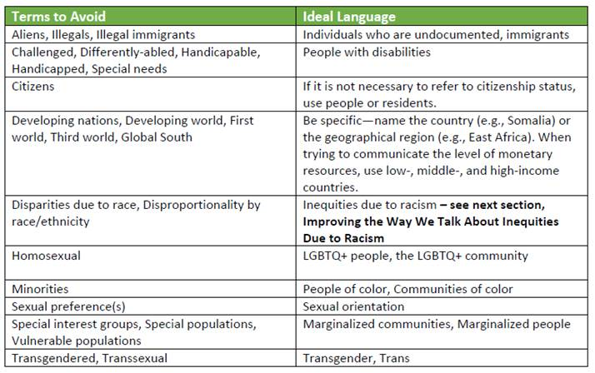
Searching for Statistics
Better Language
https://healthequity.wa.gov/Portals/9/Doc/Publications/Reports/EquityLanguageGuide_Final_.pdf
Notes:
I want to note that language changes constantly. Some of this might already be outdated.
The link will take you to the full document that has more details.
Equity Language Guide
Governor’s Interagency Council on Health Disparities
Approved December 6, 2018
https://healthequity.wa.gov/Portals/9/Doc/Publications/Reports/EquityLanguageGuide_Final_.pdf
Keep in mind, there are also nuances. For example,
People with Disabilities - Generally, people-first language is preferred as it avoids defining a person
in terms of their disability. However, some advocates prefer identity-first
language. Asking people about their preference in terminology can be a good idea
And just earlier this week I was on another webinar that suggested not saying marginalized communities but instead naming the actual community.

Slide 27
Searching for Data
EQUITY LENSE
SCOPE: Who and how many are directly affected? How severe is this?
SIGNIFICANCE: What makes this a compelling need? Is it likely to become worse? What will happen if we do nothing?
CAUSE(S): Why does the need exist? How is it perpetuated?
  Include the role current or historical inequities faced by underserved communities may play in contributing to the problem
Notes:
Just to be clear, I bring all this up for the ToC in general and how we are describing the problem but also Specifically related to answering this question, the question of “cause” when we are describing the community problem we want to address.
The updated AC application instructions now ask applicants to include “The role current or historical inequities faced by underserved communities may play in contributing to the problem” in their problem statement

Slide 28
Searching for Data
RACIAL EQUITY LENS
Language matters.
“State data have consistently pointed to differences in access and outcomes experienced by people of color. …Be explicit about racism and other forms of oppression as the underlying causes for the inequities that exist and show up in state data.”
Notes:
Equity Language Guide
Governor’s Interagency Council on Health Disparities
Approved December 6, 2018
https://healthequity.wa.gov/Portals/9/Doc/Publications/Reports/EquityLanguageGuide_Final_.pdf
This is an invitation to be explicit in your narrative about why the problem you’re addressing exists in the first place.
“State data have consistently pointed to differences in access and outcomes experienced by people of color. Examples include gaps in kindergarten readiness, disproportionality in the criminal justice system, disproportionate exposure to environmental hazards, and health inequities. When documenting these inequities, agencies have historically used language that explicitly states or implies that race/ethnicity is a risk factor.
The Council’s guidance to agencies is to be explicit about racism and other forms of oppression as the underlying causes for the inequities that exist and show up in government data. Such inequities may be due to overt interpersonal racism or institutional racism that results in policies or processes having disparate adverse impacts on people of color. When sharing information on outcomes by race/ethnicity, include context about the underlying reasons (AND WHY IT’S RELEVANT TO YOUR PROGRAM – YOU DON’T WANT THIS TO BECOME A DATA DUMP!), including lack of opportunity, policies that have a disparate
impact on people of color, effects of implicit bias on subjective decision making, and toxic stress, etc.

Slide 29


Intended Outcome
What change are you hoping to make related to the identified need?
Notes:
What change do you want your program to make?
Intended Outcome: After you have clearly identified the problem/need, the next step is to consider your intended outcome, your desired result

Slide 30
Identifying the Intended
Outcome
Economic Opportunity Program Example
Possible outcomes to measure:
  secured employment
  transitioned into safe, healthy, affordable housing
  improved job readiness
Notes:
Let’s see what an intended outcome might look like for an economic opportunity program example.
There are several possible intended outcomes to measure. We will discuss outcomes more in the upcoming modules so I won’t go into detail now.

Slide 31
Would all of these be easy or difficult to measure? Is each part aligned with their proposed intervention?
Build self-confidence
Learning will continue outside of scheduled course
Improved job readiness
Participant will maintain steady employment
Notes:
For example, if our economic opportunity program proposed the following outcomes: build self- confidence, Learning will continue outside of scheduled course, improved job readiness, participant will maintain steady employment
Would this be easy or difficult to measure? Is each part aligned with their proposed intervention?
There was no mention of a need for building self-confidence. Or learning continuing outside of the course. How would they measure that? How might they measure steady employment? That might go beyond the grant year.

Slide 32
X Outcomes that are difficult to measure or don’t align with other ToC components
Notes:
Caution: outcomes that are likely too difficult to measure or do not align with the proposed intervention and need.

Slide 33

Intervention
An intervention is the specific set of activities in which participants and volunteers will be engaged. What is the best way to achieve the intended outcome?
Notes:
Once you know what change you intend to make (your outcome), then you can determine the most effective way to intervene. In your planning grant application, you were asked to describe what activities you see AmeriCorps Members engaging in and how such interventions may lead to positive outcomes. Here’s your opportunity to revisit that.
An intervention is the specific set of activities in which your participants and volunteers will be engaged. It is the strategy you employ to bring about the change for those who will benefit from the services.
You are approaching this step with an understanding of the scope, significance and causes of the problem/need and an identified outcome or desired result.
To determine what could be an effective intervention, you will look for evidence from performance measurement, evaluations, or research studies that show your proposed intervention is likely to achieve your intended outcome. What interventions have others tried? Have they proven successful, or have they not led to the expected outcome?
Here’s an example of how evidence is useful when designing your intervention or modifying an existing intervention to make it more effective.
If evidence from an evaluation shows that some specific number of hours of physical activity for teens led to improved physical condition and health . Then you might consider having your intervention be a similar number of hours of physical activity if you are seeking to improve physical condition and health in teens your program serves.
It is important to note here that physical activity is a broad category of intervention in the same way that antibiotics from our earlier example, are a broad category. Therefore, as you review evidence of what has worked, you also need to pay attention to both the design of the intervention and the dosage received by the teens in the program that was studied.
For more detailed information on evidence – what it is, how it helps you select an intervention, where to find it, etc., hold tight for the Evidence Module.

Slide 34
Intervention
Describe the design and dosage of your intervention (service activity):
  Design (who does what with whom?)
  Dosage
    Frequency (how many sessions a week?)
    Intensity (length of each session)
    Duration (how many total weeks of sessions?)
Notes:
As part of your theory of change, you need to describe your intervention or service activities clearly. You need to identify the:
Design (who does what with whom?)
Dosage
Frequency (for example, how many sessions a week?)
Intensity (for example, length of each session)
Duration (for example, how many total weeks of sessions?)

Slide 35
Intervention Example
Healthy Futures Program Example
  Design: national service participants implement the Run Up curriculum with youth ages 17-21 to increase physical fitness and educate them on body awareness
  Frequency: twice a week
  Intensity: 60 minutes per session
  Duration: 12 weeks
Notes:
Following our Healthy Futures program example, here is the intervention description for the after-school community-based Run Up program:
Design: the Run Up curriculum serves small groups of 3-5 youth ages 17-21 to increase physical activity and educate them on body awareness
Frequency: twice a week
Intensity: 60 minutes per session
Duration: 12 weeks

Slide 36
X Interventions lacking detail or support of evidence
Notes:
Caution: interventions defined in general terms but without detail or support of evidence.

Slide 37
Intervention: Tutoring, structured physical activities, field trips etc. 3-4 hours daily, throughout the school year.
Notes:
Let’s first look at this intervention. Does it tell us what we need to know about the design? Intensity? Frequency? Duration?
Design (who does what with whom?)
Dosage
Frequency (for example, how many sessions a week?)
Intensity (for example, length of each session)
Duration (for example, how many total weeks of sessions?)
Not enough information. Can’t really tell what is going on.
This is an afterschool program but that is not mentioned in the description.
We don’t know who is providing these activities, with whom, or where.
We also don’t know what the primary activities are in which youth are engaged. Is it tutoring? Field trips? Or…?
Daily. 3-4 hours a day total. But not clear how that is split between the various activities.
Dosage sounds impressive (3-4 hours daily) but is hard to assess for any given student, especially if this is a drop-in program.
Throughout the school year
Will get more info the evidence later. How about the evidence? No supporting data from performance measurement, evaluation or research studies.

Slide 38
Intervention REFINED: 30 AmeriCorps members will provide teacher identified 3rd-6th graders 1-1 tutoring at least two hours per week and structured small group physical activities for 1-2 hours afterschool each day throughout the school year.
Notes:
Here is how we might update the intervention so that we now see “who does what with whom” and what the dosage looks like more specifically.

Slide 39
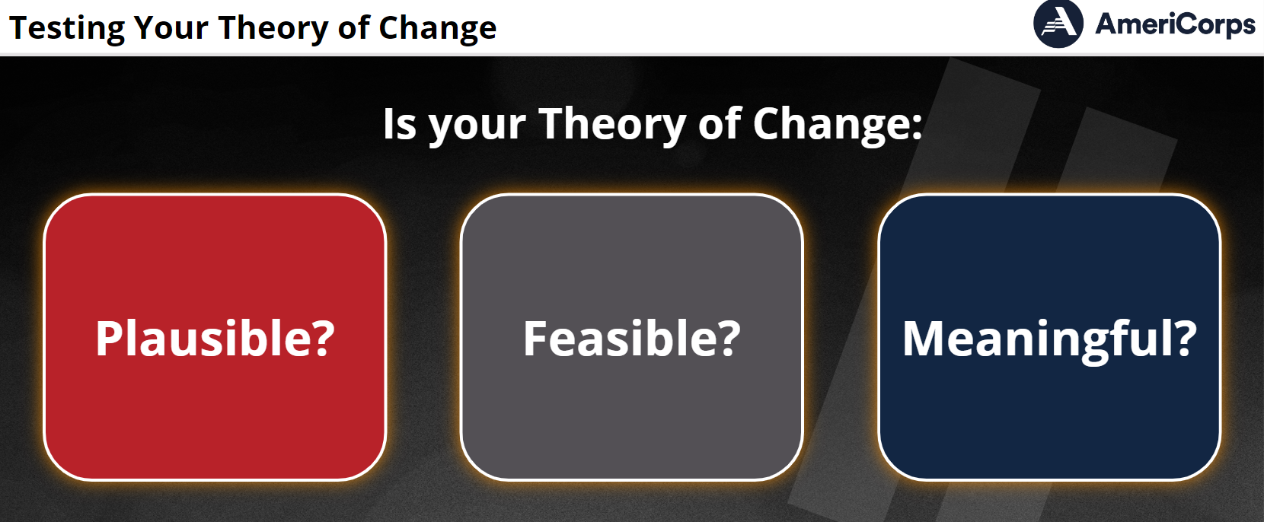


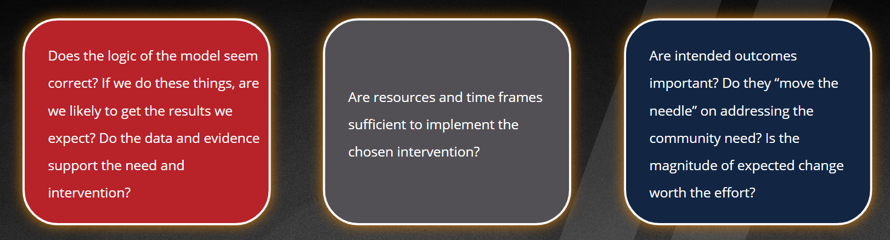
Testing Your Theory of Change:
Notes:
After you have laid out all three elements of your theory of change, ask yourself the following questions.
Is your Theory of Change Plausible: Does the logic of your model seem correct: “if we do these things, we will get the results we expect?”
Is it Feasible: Do you have enough resources to implement the intervention you have chosen?
Is it Meaningful: Are your intended outcomes important? Is the magnitude of change you expect worth the effort?

Slide 40
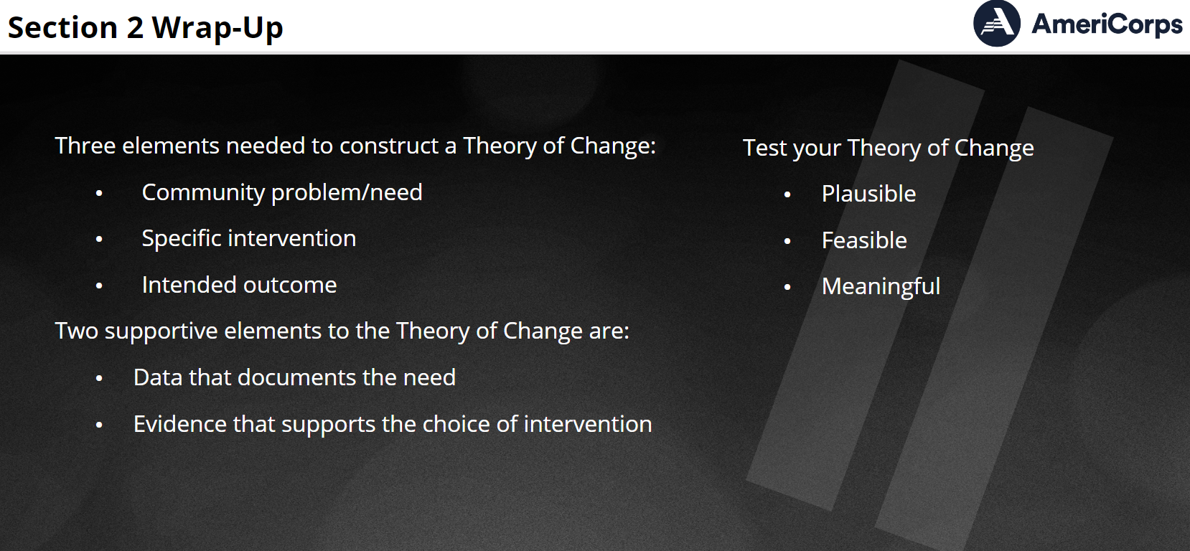
Summary of Key Points
A theory of change identifies cause/effect
The three elements of a theory of change; community problem/need, intervention, intended outcome are supported by data and evidence
Data documenting community need should show scope, significance, and causes
Notes:
To summarize the key points of this module:
Having a well conceived theory of change helps identify the pathway linking your service activities to your intended outcome
The three elements of a theory of change; community problem/need, intervention, intended outcome are supported by data and evidence
Data documenting community need should show scope, significance, and causes.
And do consider how you might apply an equity lens in communicating these aspect. And commend those of you who have been doing this already – we at Serve WA have much to learn

Slide 41
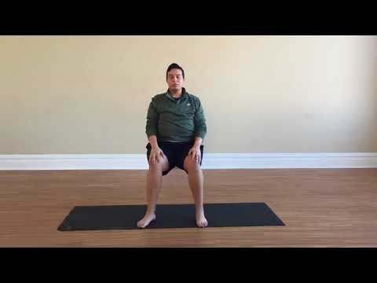
Break
10 minute stretch break!
Chair Yoga (5 minutes) https://www.youtube.com/watch?v=-YTPV0f_DFs
Notes:
Participate as you are able and interested.

Slide 42

Building Evidence of Effectiveness
Notes:
Time to jump into our second and final module for today, “Building Evidence of Effectiveness.” This module will describe how using evidence can help you select an effective intervention.

Slide 43
Module Objectives Objectives
Understand how evidence informs theory of change and program design
Be familiar with various types of evidence
Understand how to assess evidence
Notes:
You will learn how evidence supports a program’s theory of change and program design, learn about different types of evidence, and review some considerations for assessing evidence from your own program or similar programs.
This is an introductory course that focuses on developing a basic understanding of what evidence is and does. We will introduce some performance measurement and evaluation concepts that are addressed in more detail elsewhere, such as the subsequent webinar in October. Additional modules of the performance measurement core curriculum and evaluation training materials are available on the National Service Knowledge Network.

Slide 44
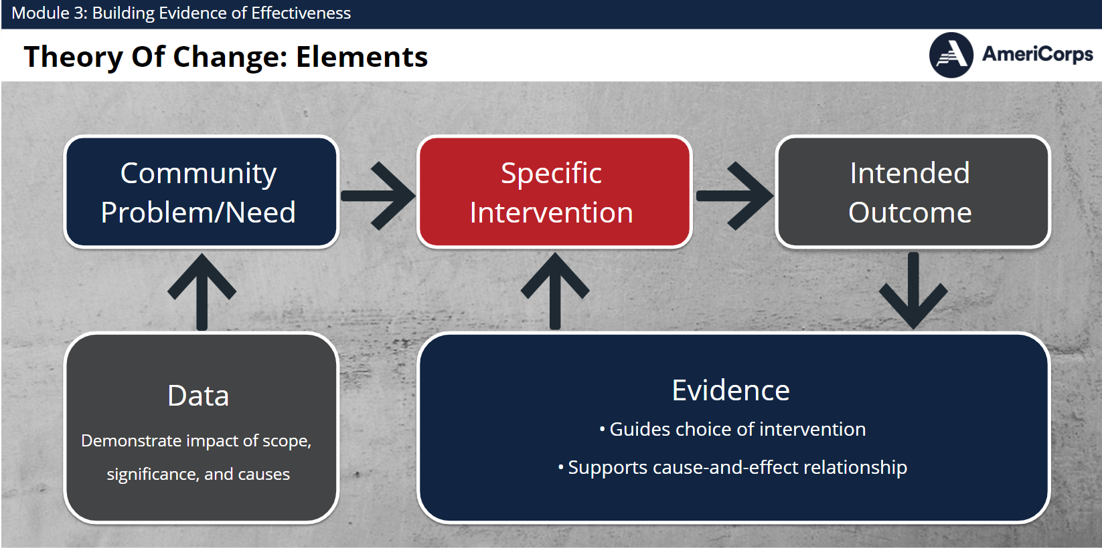
Theory of Change Elements
Notes:
Remember how evidence relates to your theory of change?
We know it is important to understand the problem – why it exists as well as how prevalent and severe it is. However, it is equally important to choose the best intervention to address the problem. A program’s choice of intervention should be informed by evidence about what approaches are, and are not, effective in addressing the problem and leading to the intended changes in beneficiaries’ knowledge, attitudes, behaviors or conditions.
Programs sometimes confuse the use of data to document the need and the use of evidence to support the choice of intervention. Both are important; however, this module focuses on the use of evidence to document the effectiveness of the intervention.

Slide 45

Everyday Life Example of a Theory of Change
Problem/Need
Strep Throat
Intervention
Antibiotics
Outcome
Healthy
Evidence
 Penicillin
 Amoxicillin
 Tetracycline
Notes:
Let’s revisit the example of a theory of change from everyday life that we discussed in the theory of change module.
If you have strep throat, the goal or outcome you want is to be healthy, that is, to get rid of the strep throat. Taking antibiotics is a great way to do that.
But every antibiotic is not equally effective with strep. Doctors know which antibiotics are most effective from past research and experience so they use that information to prescribe a course of action, in this case which antibiotic will be the best in fighting strep.
Penicillin and amoxicillin both are evidence-based interventions that have been proven very effective in fighting strep when taken a certain number of times a day for a period of time – making either of these a good choice.
Tetracycline is also an antibiotic, but it isn’t effective for strep throat, though it will help with acne. So it would NOT be a good choice of intervention. Looking at the evidence helps avoid trial and error using scarce resources.

Slide 46
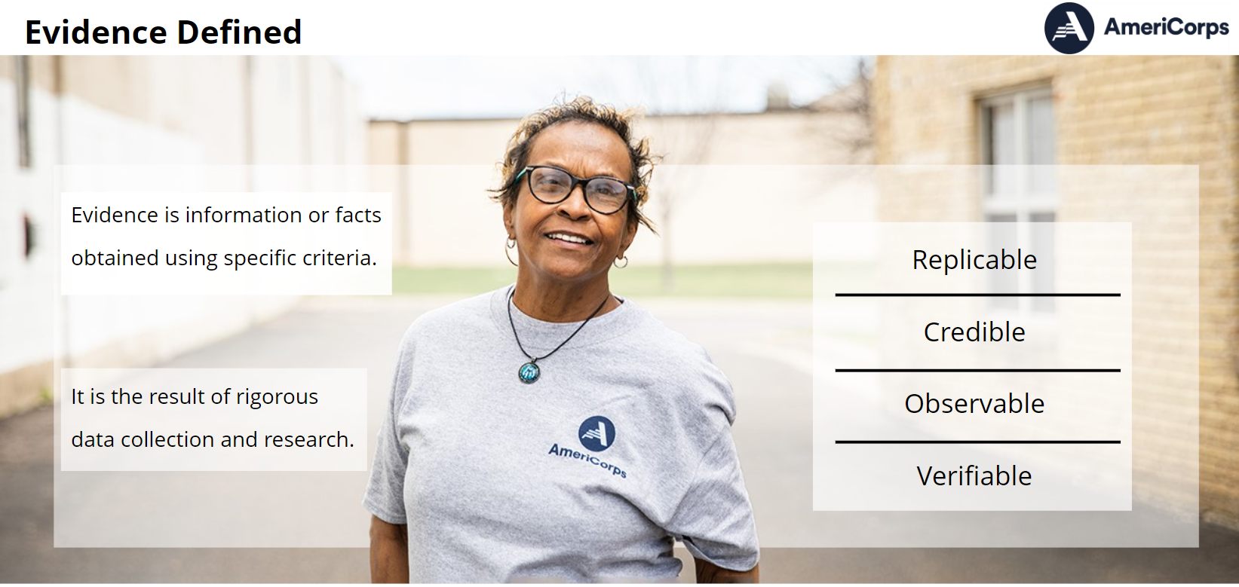
Evidence
Notes:
In the context of our work, evidence refers to information or facts that are systematically obtained in a manner that is replicable, observable, credible and verifiable for use in making judgments or decisions. In other words, evidence is the result of rigorous data collection and research. If you are starting a new program, evidence provides a sound basis to choose an intervention to meet a specific community need. Once you know what community problem you are addressing and what change you intend to make (your intended outcome), then evidence helps you determine the best intervention to use to make it happen. If you are already operating a program, evidence helps you understand whether your intervention is producing the intended outcomes.

Slide 47
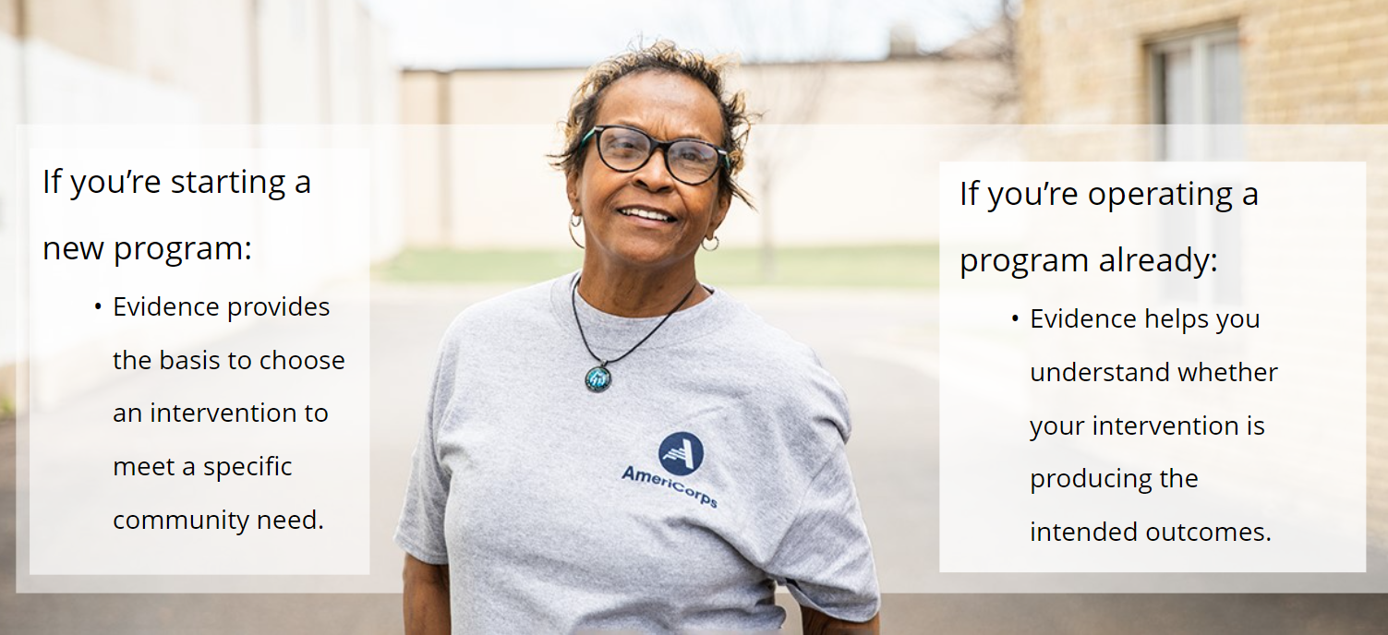
How Evidence Informs Program
Design
    New Programs Existing Programs
Notes:
Evidence shapes program design in different ways at different stages of a program’s development.
When designing a new program, evidence helps you choose an appropriate intervention design (the specific program activities) and dosage (frequency, intensity, and duration) to achieve your intended outcome. In looking at what interventions have been successful, you might choose to replicate an existing model or implement best practices from successful programs. You might also look at how and why existing interventions have fallen short and design a program to overcome those pitfalls.
It is important for existing programs to use evidence to continuously improve their program model. As you measure performance and evaluate your program over time, you may find that some pieces of your intervention are more effective than others and will need to adjust the design of your intervention accordingly. If you find that your program is not achieving the outcomes you expected, you may also find that it makes sense to choose an entirely new intervention.

Slide 48
How Evidence Informs Program
Implementation
    Existing Programs:
      Is there sufficient evidence for the intervention to continue its use?
      Based on the evidence, are there modifications to the intervention that would make it more effective?
      Do you need to choose a new intervention?
Notes:
It is important for existing programs to use evidence to continuously improve their program model. As you measure performance and evaluate your program over time, you may find that some pieces of your intervention are more effective than others and will need to adjust the design of your intervention accordingly. If you find that your program is not achieving the outcomes you expected, you may also find that it makes sense to choose an entirely new intervention.

Slide 49
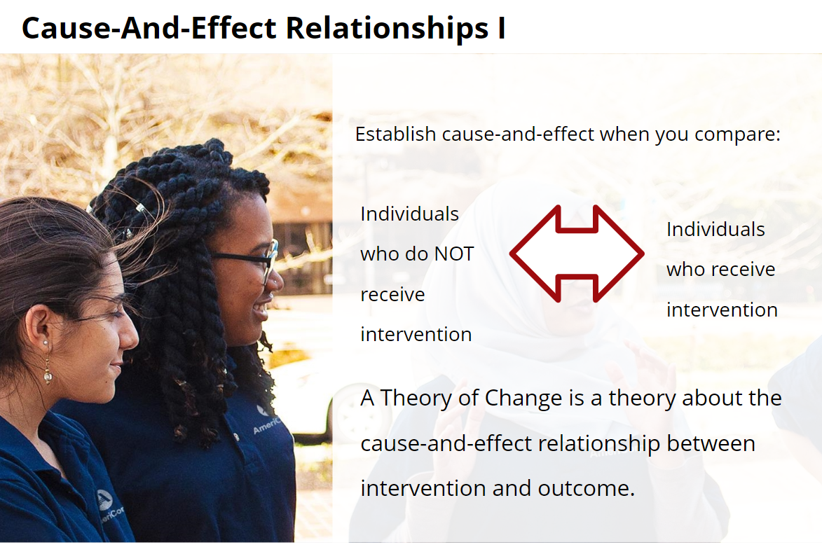

Evidence-Based
Notes:
With many program designs, AmeriCorps considers the most rigorous type of evidence to come from evaluations with a comparison or control group. These types of evaluation designs are known as quasi-experimental or experimental designs.
Just like in medicine, comparing outcomes for both individuals that do not receive the intervention with program beneficiaries enables researchers to establish whether there is a cause and effect relationship between the intervention and outcome. As we have already learned, a theory of change is a theory about the cause and effect relationship between intervention and outcome. Rigorous evaluation designs test the theory. When experimental or quasi-experimental evaluations have established that there is a cause and effect relationship between a program’s intervention and outcomes, the program is said to be evidence-based. Note: this evaluation design is only appropriate for programs of a certain size and high degree of standardization. This type of evaluation is also typically very costly and is not required of programs under $500,000 AmeriCorps share.

Slide 50
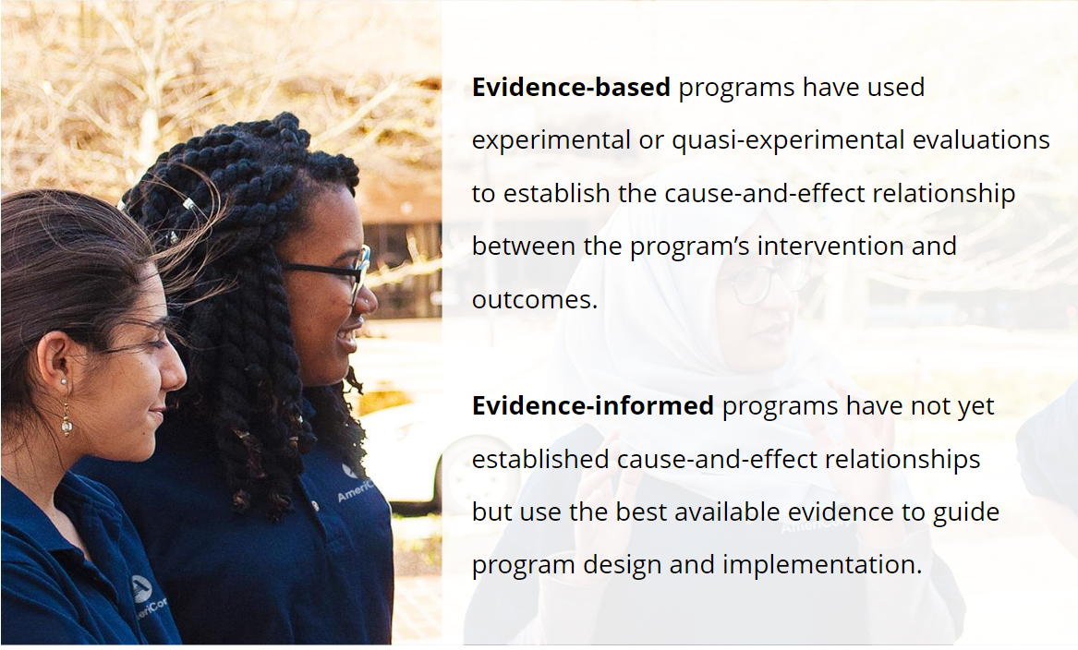
Evidence-Based
Most Rigorous Type Of Evidence
Program designs where evaluation has established a causal linkage between program activities and intended
Notes:
There is a continuum from evidence-informed to evidence-based practice. As we have already noted, new programs should begin by developing a theory of change that is grounded in evidence about what has and hasn’t worked for other programs. Over time, a program builds an evidence base first through performance measurement, then through outcome evaluation and ultimately through more rigorous evaluation designs that can demonstrate whether or not there is a cause and effect relationship between the intervention and the outcome.

Slide 51
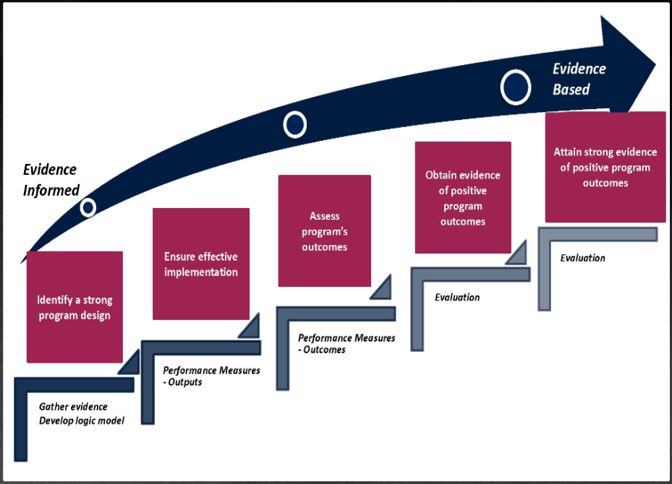
Building Evidence of Effectiveness
Evidence Based
Obtain evidence of positive program outcomes
Assess program’s outcomes
Ensure effective implementation
Notes:
AC has created a visual of the continuum from evidence-informed to evidence-based practice. New program models should begin by developing a Theory of Change and over time build their evidence based first through performance measurement, then through evaluation.
The process of building evidence is not always linear. Findings at any stage of the process may result in program design changes that may cause a program to return to earlier steps. For example, a program that is not meeting its performance measure outcomes (step 3) may decide to go back to the drawing board and look at evidence for other interventions (step 1). They may also go back to step two to determine if some aspect of the program is not being implemented correctly.
Evidence at all stages of the continuum is valuable. Positive findings at any stage help to build the program’s evidence base. Negative findings or findings that show no effect can be used to change and improve the program. AC funds programs at all stages of the continuum, but all programs should seek to strengthen their evidence and improve their program model over time.

Slide 52
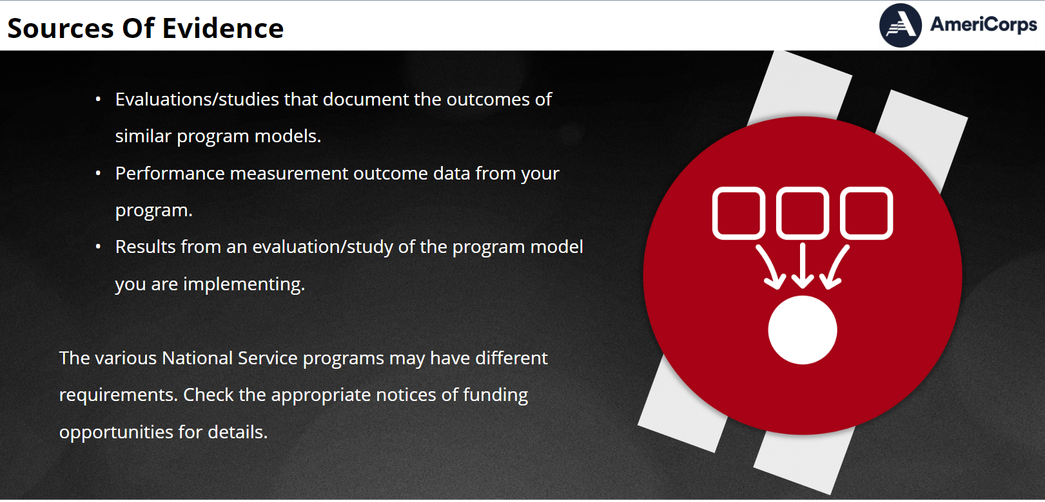
Evidence Basis for Interventions
Notes:
Now that we have discussed how programs build evidence over time, we will discuss how to find and evaluate evidence to support your theory of change.
Common sources of evidence include:
Evaluations that document the outcomes of similar programs – As noted earlier, programs that rely on evidence from similar programs fall toward the beginning of the continuum we looked at on the previous slide.
Performance measurement outcome data from your program – Using evidence from performance measurement data puts programs on the second or third step of the evidence continuum.
Results from an evaluation of your program outcomes. – Depending on the type of evaluation conducted, programs using this type of evidence may be on the third, fourth or fifth step of the continuum.
Different size programs have different requirements, so be sure you are aware of where your program falls.
Now let’s look at each of these sources in more detail.

Slide 53
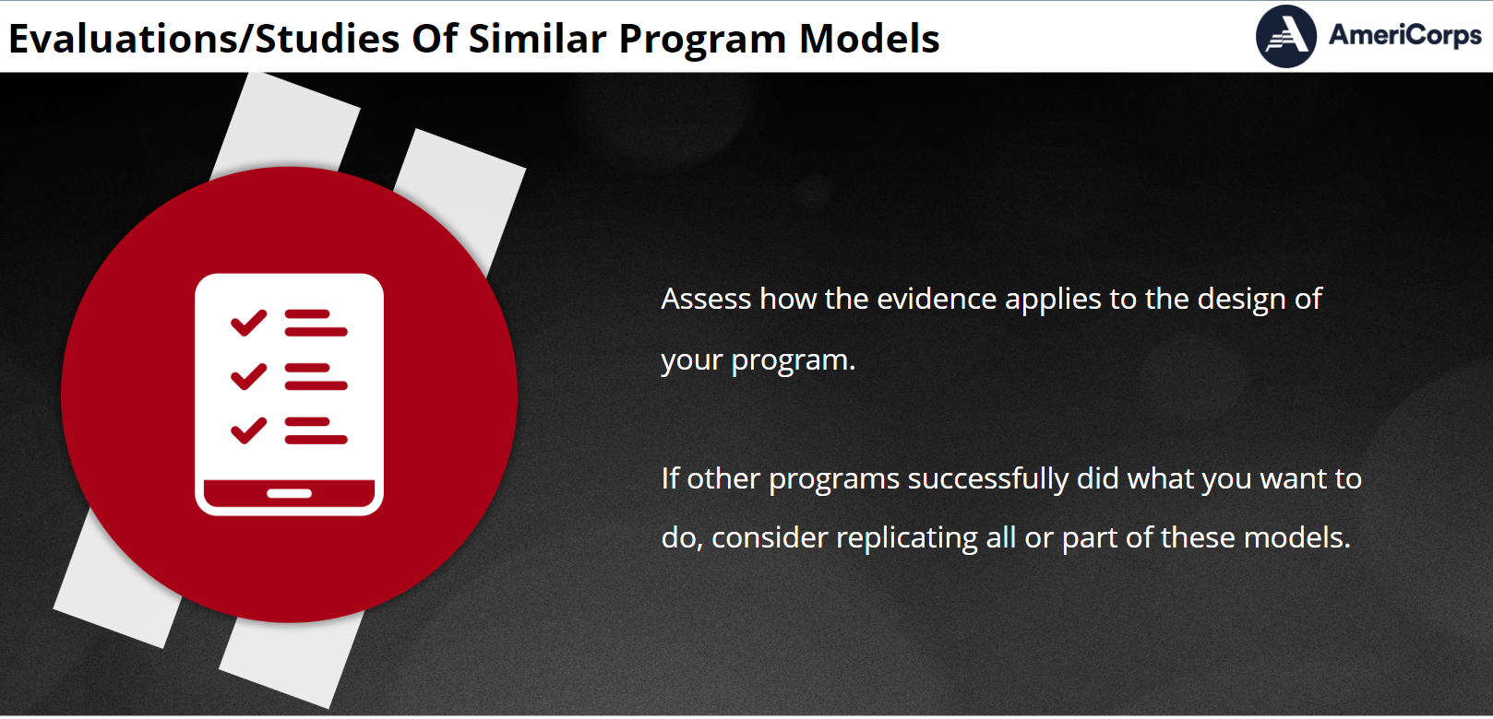
Evidence Source: Evaluations from Other Organizations
  Have similar programs been successful in achieving the outcomes you want your program to produce?
Notes:
The first source of evidence includes evaluation results from other programs. When considering this evidence, you need to assess how applicable the evidence is to the design of your program. If other programs have successfully done what you want to do, you may consider replicating all or part of these models into your own model.
We are going to cover how to search for this in a few slides.

Slide 54
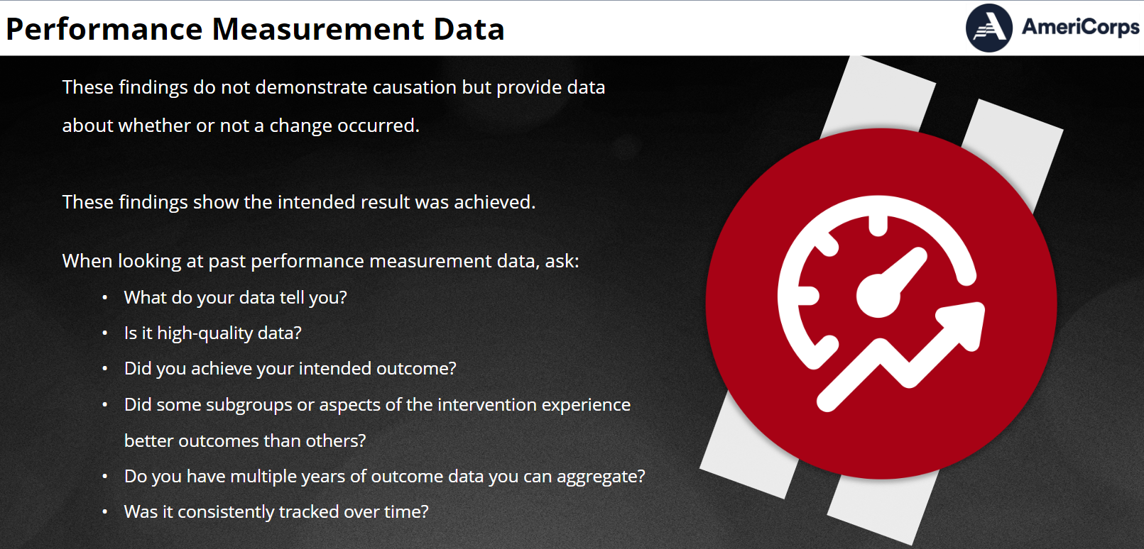

Evidence Source: Your
Performance Measurement Data
  Past performance measurement outcome data:
    What do your past performance measurement results tell you?
    Can you show positive outcomes over time?
Notes:
Another source of evidence is your own past performance measurement data on outcomes. Past outcome findings from performance measurement do not demonstrate causation but they do provide data about whether or not a change occurred.
Therefore, while outcome data from performance measurement can't show that the change occurred because of your specific intervention, it is useful because it shows the intended result was achieved. If you are looking at your past performance data as evidence for an intervention, consider:
What do your data tell you? For example, did you achieve your intended outcome?
Do you have multiple years of outcome data you can aggregate? Using data from multiple years makes a stronger case for the effectiveness of your intervention. If you have it, use it!

Slide 55
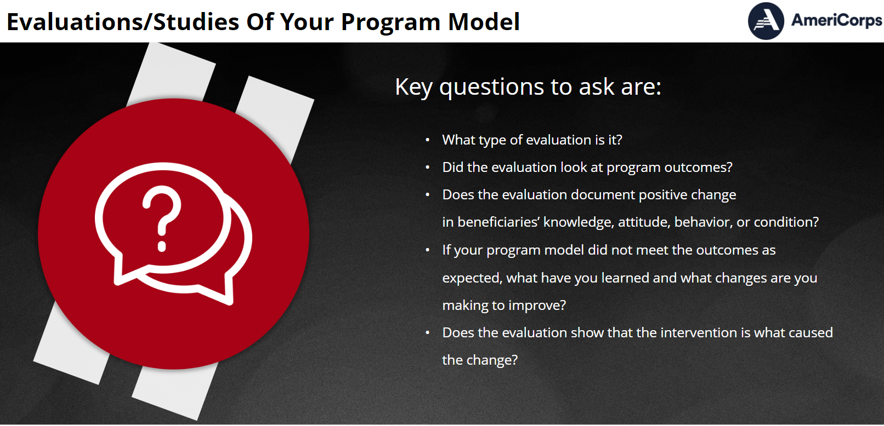

Evidence Source:
Your Program Evaluation
Notes:
Another source of evidence can be the results of an evaluation of your program outcomes. This could range from an evaluation that looks at a change in beneficiaries over time to an evaluation with a comparison group that looks at whether there is a causal link between the program activities and outcomes.
Key questions to ask are:
What type of evaluation is it? Did your evaluation look at program outcomes? A process evaluation that looks at how your program was implemented but does not assess outcomes or causation does not provide evidence to support the effectiveness of your intervention.
Does the evaluation document changes in beneficiaries’ knowledge, attitude, behavior or condition? If your program did not meet the outcomes as expected, what have you learned and what changes are you making to improve?
Does the evaluation show that your intervention is what caused the change? Not all outcome evaluations demonstrate causation.

Slide 56
Assessing Evidence
Considerations:
  Similar: Cites comparable intervention with similar beneficiaries and results
  Significant: Findings show that the program had a positive and statistically significant effect on beneficiaries
  Up-to-date: Recently published or most recent available
  High Quality: Use well-implemented and appropriate research methodologies given the research questions of interest
  Reputable: Source with no stake in outcome and published in a peer reviewed journal or by credible organization
Notes:
There are several factors to consider when assessing evidence from your own or from other programs. If looking at evidence from other programs, you need to be sure that the intervention that was studied is similar to your program intervention. Was the intervention similar in design, dosage, the type of beneficiaries served, and outcome achieved? If not, it may not be similar enough to use as evidence for your theory of change. Evidence that is not similar would not refer to the same population or may not be a comparable intervention (for example, participants receive intensive ongoing case management services as opposed to a one-time assessment and referral session).
Other considerations for evidence from your own or a similar program include: Is the evidence significant? Do the findings from the study or studies indicate with confidence that the program model under study had at least one positive and significant effect on target beneficiaries or entities? “Significant” means the results were statistically significant, often statistical significance is set at the 95% confidence level (or p<0.05). Is the evidence up-to-date? Was it published recently and has it utilized current thinking around the issues? Studies conducted within the past six years are considered recent. Studies older than six years may also be satisfactory provided that there is reasonable confidence that the relevant conditions in which the program operated when studied are the same or similar as the conditions that exist now. Does the evidence have high methodological quality? Do the study or studies use well-implemented and appropriate research methods given the research question of interest, using high quality data, sufficient sample size/statistical power, and a representative sample? If you do not have a background in research or statistics, it may be difficult to determine the quality of a study. The final consideration, whether the study comes from a reputable source, can help you feel more confident in its quality. Is the evidence from a source that had no stake in insuring a positive outcome, such as a university or a government agency? Was it published in a peer reviewed journal or as a research study from a credible organization? Peer reviewed journal articles are great sources of information because they have been screened and selected based on their merit by other professionals in that field.

Slide 57
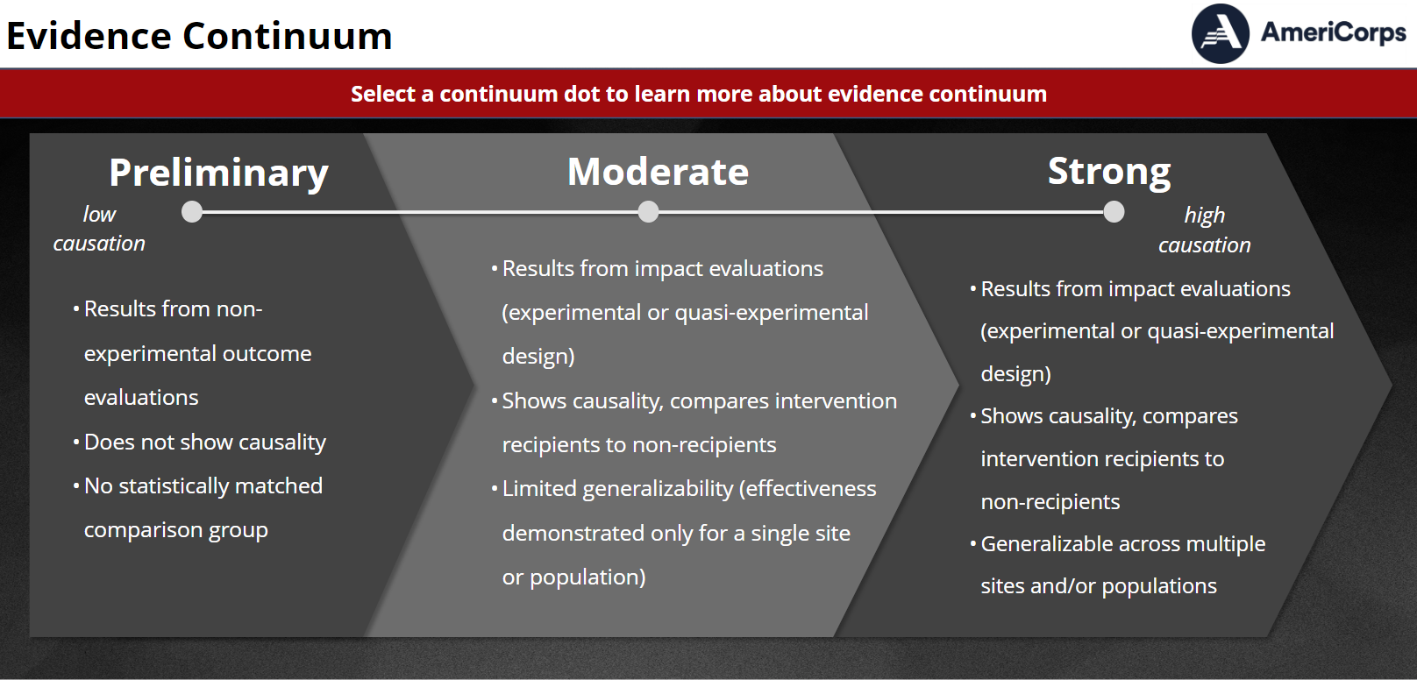
Evidence Continuum
Causation
  Low High
Notes:
Earlier, we looked at the evidence continuum as a series of steps. This slide shows another way of classifying the various stages along the continuum. As we saw earlier, programs at the moderate and high ends of the continuum have conducted more rigorous research designs designed to determine whether a cause and effect relationship exists between the intervention and outcome.
Performance measurement and outcome evaluation look at whether a program achieved its intended outcomes over time, often with a pre/post test. Performance measurement and outcome evaluation results can only show that a change occurred and that the intended outcome was achieved. They are not able to prove that the intervention caused the change. Therefore, outcome results are considered by AC to provide pre-preliminary or preliminary evidence. Robyn will be sharing additional detail on the evidence tiers, which evolve with each NOFO (and should not be confused with the evidence continuum).
Impact evaluations use rigorous data collection methodologies that go beyond just documenting that a change occurred to determine whether the intervention caused the change. They are designed to collect data from people that received the intervention, as well as from similar people that did not. This allows a comparison between the two groups and sheds light on causality.
In some cases, researchers and evaluators are able to randomly assign people to one of the two groups – those that receive the series and those that don’t. This is called an experimental design and is generally the most complex and expensive of the data collection methodologies. It is highly rigorous and can produce very high quality data documenting that the intervention caused the outcome. Studies using random assignment are considered strong evidence.
However, when unable to assign people randomly to groups, researchers often use comparison groups – groups of people similar to those receiving the service – as a way to get at causality. This is called a “quasi-experimental design.”

Slide 58
Evidence Continuum
Shape Up: afterschool fitness program
Pre-preliminary/ Preliminary | Moderate | Strong
Performance measurement shows that 75% of girls age 14-16 participating in the Shape Up program increased knowledge of healthy food choices. Outcomes evaluation showed that 65% of girls in the program made more healthy food choices | A 2005 impact evaluation by external evaluators (using a quasi-experimental design) found that after 12 weeks, the 30 girls in the program serving one community center made 50% more healthy food choices than the comparison group. | A 2010 impact evaluation of the program by University of MN using experimental design/ random assignment found after 12 weeks, the 350 girls in the experimental group, selected from a representative sample of sites across the state, made 50% more healthy food choices than control group girls
Notes:
Here’s an example of what evidence might look like along the continuum for an afterschool obesity prevention program called Shape Up.
Preliminary evidence is from the program’s own past performance measurement findings: the program found that… This evidence is considered preliminary because there was no comparison group, so while it shows a change occurred we can’t be sure that change happened because of the intervention.
At a moderate level along the evidence continuum, you might use something like this. This is considered moderate because it used a quasi-experimental design, which means girls were not put into groups randomly. And it only used data from a small sample so results can’t be generalized to other sites,. So the data are considered less rigorous.
Strong evidence might look like this. This evidence is considered to be on the strong end of the continuum because it is used random assignment or an experimental design, the sample was large and representative of the population served.

Slide 59
Searching Online
https://www.nationalservice.gov/impact-our-nation/evidence-exchange - AmeriCorps Evidence Exchange
https://scholar.google.com/ - Google Scholar
https://ies.ed.gov/ncee/wwc/ - What Works Clearinghouse - reviews the existing research on different programs, products, practices, and policies in education
Notes:
(If ample time, could demo one of these)

Slide 60
Key Points
Evidence helps us understand whether or not a program is achieving its intended outcomes
A program’s theory of change should be informed by evidence about what interventions are, and are not, likely to be successful in achieving the intended outcomes
The strength of a program’s evidence exists on a continuum, and different types of evidence are appropriate at different stages of a program’s life cycle
Factors to consider when assessing evidence quality include: similarity, significance or strength of findings, recency, quality and whether the evidence is from a reputable source
https://americorps.gov/grantees-sponsors/national-performance-measurement-core-curriculum
Notes:
In summary:
Evidence enables us to determine whether or not a program is achieving its intended outcomes
A program’s theory of change should be informed by evidence about what interventions are, and are not, likely to be successful in achieving the intended outcomes
There are many different types of evidence, each with unique value and limitations
There are many factors to consider when assessing evidence

Slide 61
Quarter 1 Homework
Questions to Consider
Is there alignment between need, intervention, and intended outcome? Clear design/dosage?
What level of evidence supports this alignment?
Which aspects of your program are best measured annually?
How many AmeriCorps members will be needed? Are the member activities allowable?
What are the characteristics and qualifications of desired AmeriCorps members?
How many staff members and what roles will be supporting the program and members?
Are partner agreements necessary for data collection? How will members be oriented to data collection?
What checks and balances will be needed to ensure fidelity in data collection?
Will you have host sites? What other partners are necessary to be successful?
How will you obtain the cash match necessary to operate the program?

Slide 62
Deliverables
☐ Theory of Change Framework and Logic Model
☐ Performance Measure(s) and Data Collection Plan
☐ Operational Grant Application (submitted in eGrants), if applicable
Submit to Lou and Jenny by the end of November. We will continue to discuss/asses throughout the planning grant year.
Lou Thompson – lou.thompson@ofm.wa.gov
Jenny Benson – jenny.benson@ofm.wa.gov
Notes:
This is the start of your Qtr. 1 deliverables list. We will be adding a couple components after the next webinar that completes this two-part webinar. Getting started on a ToC is part of your homework, but you will wait to submit until you have the associated pieces and trainings to come on Sept 1. Templates available (or use your own) and will be posted on your planning grants webpage.

Slide 63

Closing

