Slide 1
Subgrantee Quarterly Update
April 27, 2023 – 10:00am
Please sign-in via the chat box:
Organization/Program
Name(s)
What is energizing you at work?
Notes:
The law requires consent prior to recording a person’s participation in an event. Please be advised that your image will be captured and recorded during the videoconference. Your participation in this videoconference equals consent to be recorded as required by law. We will be publishing this video on our website located at servewashington.wa.gov. If you do not consent to being recorded but choose to participate, please turn your camera off and use the chat feature to interact with the speakers. You may also disconnect now
Ok, we are officially recording, welcome once again. I’ve posted the consent information in the chat box which was read aloud prior to starting this recording. If you haven’t done so yet, please sign in…

Slide 2
AGENDA
10:00 am | Welcome and Sign-In | Jenny Benson
10:05 | Recruitment Service Year Platform Serve Washington support Padlet Activity What strategies have been successful for recruitment? What are new recruitment strategies you are trying? How can Serve WA support your recruitment efforts? How have you shifted how you use social media? | Jenny Benson
10:25 | Communications Corner Social Media Newsletters PSA Year-end Celebrations | Rachel Friedrich
10:35 | Unexpended Funds Formula Unexpended Competitive Carryover | Thomas Darnell
10:45 | Serve Washington Updates New Staff WA Climate Corps State budget update Member Benefits Exit timeline Workforce Development | Jenny Benson
11:15 | Serve Washington Events and Trainings Skill Up Review Upcoming Events & Training | Mary Van Verst
11:30 | Adjourn and THANK YOU | Jenny Benson

Slide 3
Recruitment Resources
ASC Recruitment Support Materials
Learning Modules
Recruitment Resource Guide
*Templates do have legacy logo that will need updating
Basecamp
Peer Resource Library

Slide 4
Recruitment Resources
Service Year
State-wide network
Customized questions
Resource Hub
Member retention support
Notes:
Must post in eGrants
Lots of flexibility with applications so what will remove the most barriers
Retention support: Virtual Companion, Resource Hub, Service+Tech, and the AmeriCorps Alums

Slide 5
Serve WA Recruitment Efforts
Additional Staffing Support:
Paige Sharp
Recruitment and Engagement Program Manager
Service Year Alliance Grants
Opportunity For All
Post-Secondary Pathways Cohort
Notes:
State-wide, cross program recruitment group
Alumni Ambassadors and speakers bureau
$50k
High school credentialed members who can get career pathway support – real world credentials
$25k

Slide 6
Serve WA Recruitment Efforts
Additional Staffing Support:
Rachel Friederich
Communications Coordinator
Recruitment Campaign
Increased communication efforts
Drive people to Service Year

Slide 7
Let’s hear from YOU!
Padlet Activity
What strategies have been successful for recruitment?
What are new recruitment strategies you are trying?
How can Serve WA support your recruitment efforts?
How have you shifted how you use social media?

Slide 8
Communications Corner

Slide 9
Social Media: Help us find your content!
Hashtag vs. Tag: What should you use?
Hashtags # are meant to get a identify a
topic of interest or get a topic trending.
It can take thousands of # to get a topic
trending.
Lots of effort. Gets lost.
Not sorted by date or location
Broad. #will find every topic related.
Demonstration

Slide 10
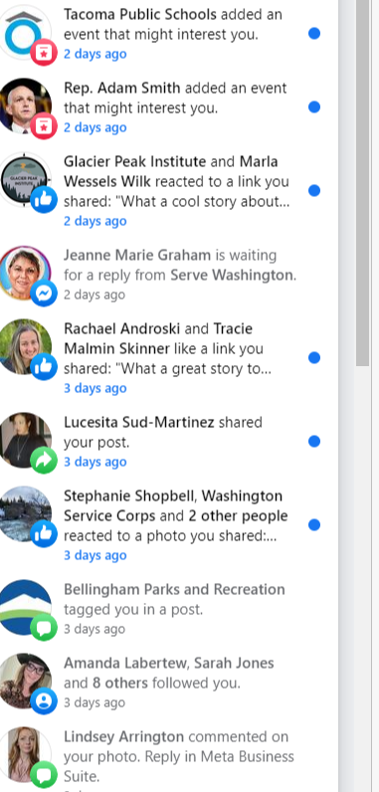
Social Media: Help us find your content!
Hashtag vs. Tag: What should you use?
Tags (@SocialMediaHandle) are meant to
ENGAGE individuals when you mention
them in a post of content.
When you tag someone, they get a
notification, which can prompt a share.

Slide 11
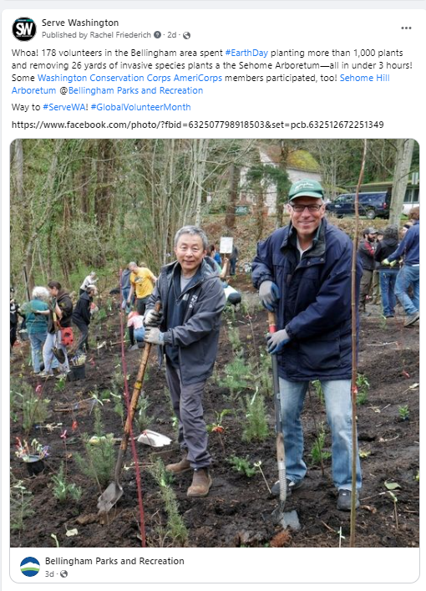
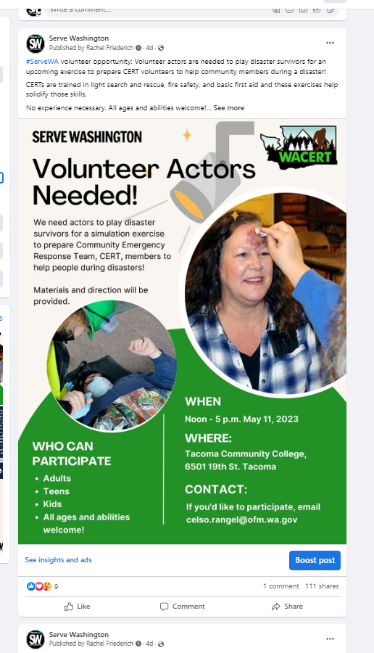
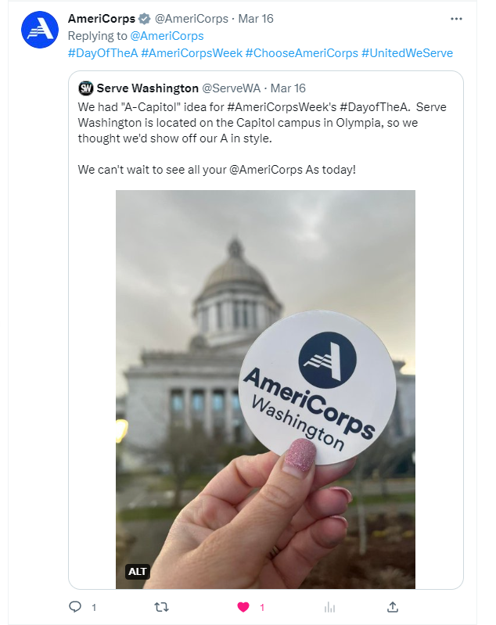

Slide 13
Newsletters!
Two Newsletters. Started this year.
General Public
One way to keep stakeholders in the know about SW initiatives
2. AmeriCorps Members
Lets them know about events, trainings
INTERACTIVE!

Slide 14
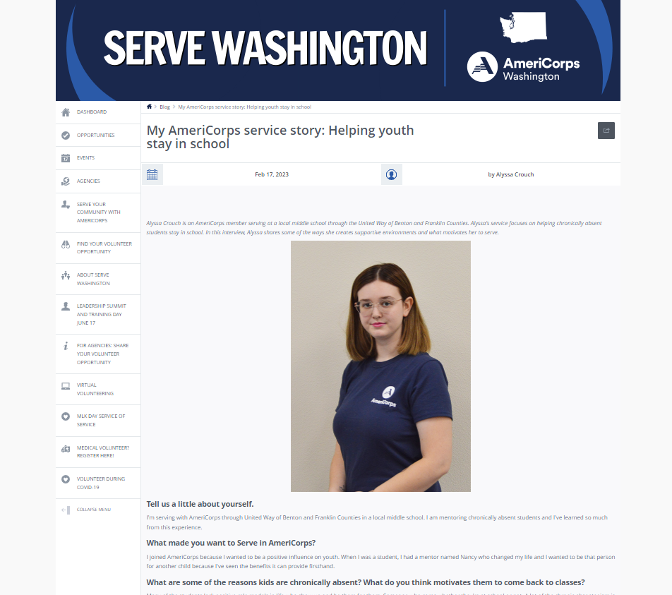
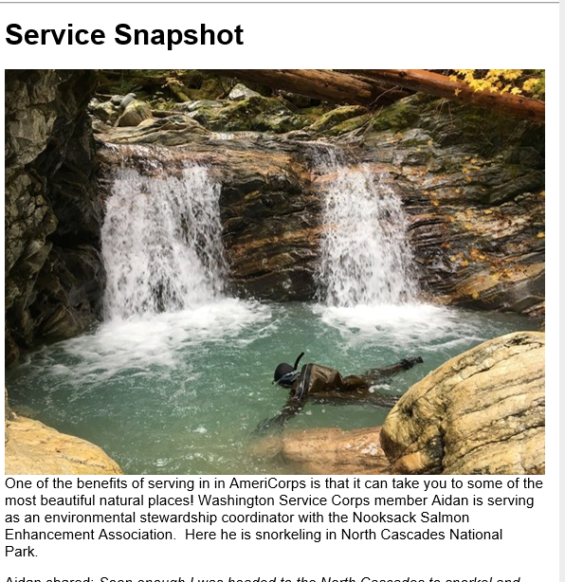
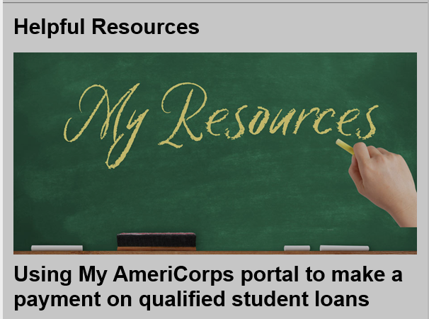
Newsletters!

Slide 15
Sign Up!
Servewashington.wa.gov

Slide 16
Bonus Content: Choose AmeriCorps PSA
Toolkit: AmeriCorps Recruitment (socialpresskit.com)
AmeriCorps Box:
1920x1080 AmeriCorps 30 FF02_PartnerWashington.mp4 | Powered by Box
Notes:
End of year celebrations

Slide 17
Unexpended Funds & Carryover
Formula
Reported unexpended in March, but may have more
Can it support Recruitment???
Competitive
NEW! Carryover funding from PY 22-23 to PY 23-24
Max cost per MSY still in place
Match requirements met or approved waiver

Slide 18
General Announcements
New Staff
Washington Climate Corps
State Budget Updates
Grant Making Update
Member Benefits
Exit Timeline
Workforce Development Evaluation

Slide 19
New Serve WA Staff
Paige Sharp
Recruitment and Engagement Program Manager
Sian Newman
Program Officer

Slide 20
WA Climate Corps
HB 1176 - Developing opportunities for service
and workforce programs to support climate-ready communities
Washington Climate Corps
Augments member living allowances
Reduce cost for host organizations
Support service members ineligible for federal funds
State Workforce Board to forecast and track job demand in clean energy
Notes:
HB 1176

Slide 21
Other State Budget Wins
6 Decision Packages requested – 4 Funded:
AmeriCorps Equity Fund (BIPOC)
Serve WA ARPA Funding
Serve WA Support
AmeriCorps Equity Enhancement to Living Allowances
Exciting Times Ahead!!!
Notes:
Emergency funds
Serve WA ARPA funding $3 mil
BIPOC Equity funds $1.3
Career pathway
Serve WA Support $1 mil
AmeriCorps Equity enhancements to living allowance $4.4

Slide 22
FY 23 AmeriCorps NOFO
PY 23-24 Grant-Making
Increased Living Allowance for FT
$17,600 – $35,200 ($1,098 increase to the minimum)
Increased Maximum Cost/MSY
$23,000 ($1,400 increase)
Ed Award
amounts here
pay attention to FY
Slot Type | Hours | Education Award
FT | 1700 | $ 6,895.00
TQT | 1200 | $ 4,826.50
HT | 900 | $ 3,447.50
RHT | 675 | $ 2,626.27
QT | 450 | $ 1,824.07
MT | 300 | $ 1,459.26
AT | 100 | $ 388.03
Notes:
For FY 22 living allwance increased by $502 so this is a big jump!
Cost/MSY increased by $1,600
National Service Training talked about a per hour amount – DON”T change how you look at or speak to

Slide 23
FY 23 AmeriCorps NOFO
Competitive
Resolution nearly complete
THANK YOU for the quick turn around
Mid July - AmeriCorps Notice of Grant Award (NGA)
Formula
April 21 – GRC met
May 2 – clarification starts
May 9 – clarifications DUE
May 15 – Official notification of Serve WA Commissioner vote
Mid July – AmeriCorps Notice of Grant Award (NGA)
Notes:
For FY 22 living allowance increased by $502 so this is a big jump!
Cost/MSY increased by $1,600

Slide 24
Serve WA Updates
New Training Requirement
Key Concepts of Financial Grants Management
In Litmos
Requirement will be in the 2023 Terms and Conditions
Annual Subgrantee Meeting
IN PERSON!!!
Location TBD
July 13 – 14, 2023
Padlet Activity
What training topics would be helpful for us to cover?

Slide 25
Serve WA Updates
Member Benefits
Only actual living allowance counts toward max
Guidance from Serve WA soon
Exit Timelines
You must exit your members within 30 days
Pleas pay attention to exit dates – assess your systems now
Take eGrants screenshots or print exit report if making any changes after the fact
Workforce Development Offerings
Illuminate Evaluation Services will conduct an evaluation on Basta and SkillUp
Conducting member surveys and interviews
Notes:
Survey 10 min
Interview 30
Members who participated and those who did not

Slide 26
SkillUp
60 college level courses in member identified area
Social impact
Business
Healthcare
Technology
Universal skills
AND Access to the full Coursera and EdX catalogues!
217 spots still available
Members between ages 17-25
Access to courses through October 2023
Encourage your members to sign up today
Notes:
Can count as training hours
If a member is outside of 17-25 and interested let us know

Slide 27
EVENTS CALENDAR
Upcoming Events | Dates | Point of Contact | Additional Info
AmeriCorps Week | March 12-18 | TBD | Now includes AmeriCorps Seniors, too.
Volunteer Week Mariners Salute | April 16-22 April 22 | Denise
Points of Light Conference | July 14-16 (Chicago, IL) | Points of Light | National Conference on Volunteering and Service pointsoflight.org/conference
Year-End Celebrations | Varies | Programs | Invite VIPs, Serve WA staff, Commissioners
Swearing In Ceremony | October 20 | Mary | Get on calendars now! 😊
Notes:
Reminder to invite us to End of Year celebrations

Slide 28
TRAINING CALENDAR
Upcoming TTA | Dates | Point of Contact | Additional Info
Subgrantee Quarterly TTA Webinar | January 26 10am-11:30am | Jenny
Leader Corps | February and March | Mary
Regional Conference | March 21-23 (San Diego, CA) | Jenny | There will be a virtual option in June as well
Subgrantee Quarterly TTA Webinar | April 27 10am-11:30am | Jenny
Leadership Forum for National Service Execs | May online June in-person (UW, Seattle) | Katharine
Annual Subgrantee Meeting | July 13-14 | Jenny
*Events and Training in red are required, items in white are highly encouraged and may be elevated to required for some programs

Slide 29
Closing
Questions?
Annual Meeting Next! July 13-14 In-person
???

